Slide 1
Atomic Model Review

Slide 2
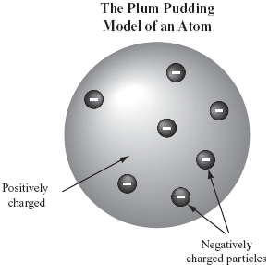
Plum Pudding Model 1897
Proposed by J.J. Thomson
Altered Dalton’s model with discovery of electron
Electrons surrounded by a soup of positive charges (to balance out the atom with an overall neutral charge)
Disproved by Rutherford

Slide 3
Rutherford’s Gold Leaf Experiment
Done in 1911
If Plum Pudding model was accurate, alpha particles should have passed with few minor deflections
Note, alpha particles have positive charge
Result:
Most alpha particles pass through without deflections
Some deflected at very large angle
A few bounced directly back to the source of the alpha particles

Slide 4
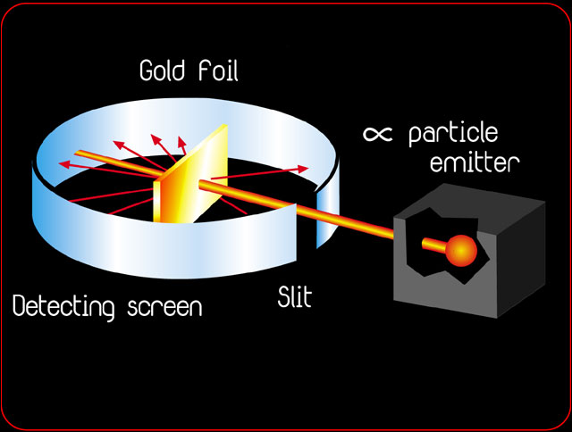
Rutherford’s Gold Leaf Experiment

Slide 5
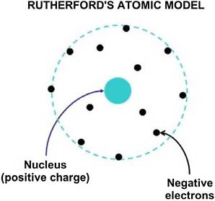
Rutherford’s Gold Leaf Experiment
Conclusions
Most of the atom is empty space
There is a dense structure in middle which contains the positive charge → Nucleus
Believed that the electrons were outside the nucleus, in no particular order

Slide 6
Rutherford-Bohr Atomic Model
Bohr improved on the model by determining that electrons were in specific orbits around the positively charged nucleus
These orbits have specific set of distances from the nucleus
Electrons in orbitals closer to the nucleus are harder to remove, as they are more strongly attracted to the positively charged core
Electrons in orbitals further from nucleus are easier to remove, as the positvely charged core has less attraction to them due to the distance between it

Slide 7
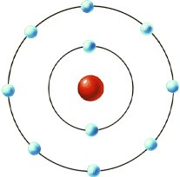
Rutherford-Bohr Atomic Model

Slide 8
Rutherford-Bohr Atomic Model
1st orbital → Max 2 electrons
2nd to n^{th} orbital → Max 8 electrons
The period tells you how many electron shells/how many orbitals
The group tells you how many valence electrons
The atomic mass tells you how many protons are in the atom
In neutral atoms, it also tells you how many total electrons there are

