Slide 1
The Atmosphere and Space Chapter 7

Slide 2
The Atmosphere
The layer of air surrounding the Earth
Helps block harmful UV rays from the sun
Controls the climate by retaining heat
Contains oxygen needed for respiration and carbon dioxide needed for photosynthesis
Extends 10 000km above the surface of the earth

Slide 3
The Atmosphere
21% oxygen, 78% nitrogen and 1% other gases
Water vapour is important for cloud formation and humidity

Slide 4
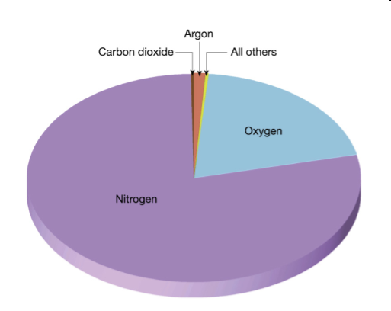

Slide 5
Layers of the Atmosphere
Troposphere (0-15 km)
Storms from here
Temperature drops 6.5°C every 1000m
2. Stratosphere (15-50km)
Ozone layer absorbs UV rays
Temperature rises with altitude
Air is thin

Slide 6
Layers of the Atmosphere
3. Mesosphere (50-80 km)
Coldest layer, down to -80°C
Few air particles, impossible to breathe
4. Thermosphere (80-500 km)
Hottest layer, up to 1800°C
Shooting stars visible here
Aurora borealis (Northern lights)

Slide 7
Layers of the Atmosphere
5. Exosphere (500km and more)
Layer is almost empty (almost no air)
Observations come from satellites and space travel

Slide 8
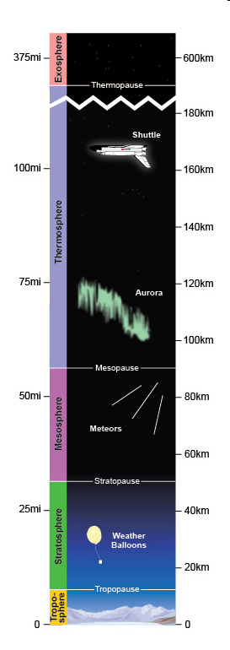

Slide 9
Atmospheric Pressure
Determined by the number of particles in a given space
Pressure is a result of the collision of air particles
More particles = more collision =more pressure
On Earth, the pressure at sea level is 101.3 kPa

Slide 10
Atmospheric circulation
The movement of the layer of air surrounding the Earth
Warm air rises at the equator and circles back to the poles where it is cooled
Cold air makes its way toward the equator and cycle starts again
When warm air rises it creates a low pressure area, associated with cloud formation
When cold air descends, its creates a high pressure area, air dries out and is associated with clear skies

Slide 11
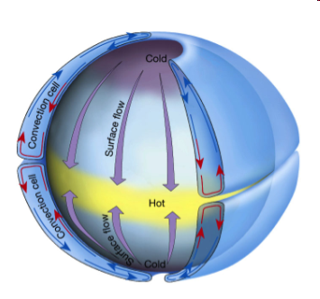
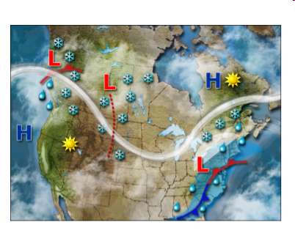
Atmospheric circulation

Slide 12
Coriolis Effect
Rotation of the Earth causes winds to move to the right in the northern hemisphere and to the left in the southern hemisphere
In Quebec this means that weather systems move from west to east

Slide 13
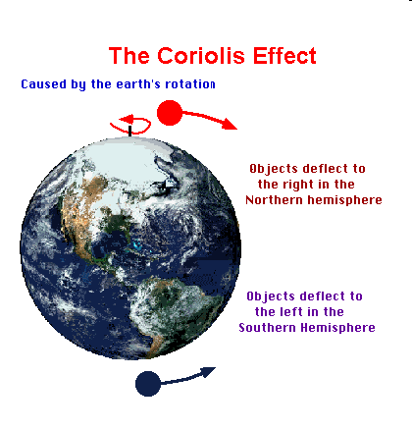

Slide 14
Circulation Cells
Winds form loops called circulation cells
Each hemisphere has 3 cells
1. Hadley cell
From the equator to the 30th parallel
Warm air rises, moves north or south to the 60th parallel
Collides with winds from Ferrel cell and moves back toward equator

Slide 15
Circulation Cells
2. Ferrel cell
From the 30th parallel to the 60th parallel
Air moves toward poles, collides with air from Polar cell
Air rises and returns to 30th parallel
3. Polar cell
From 60th parallel to the poles
Air moves to the poles and cools
Air sinks and returns to the 60th parallel

Slide 16
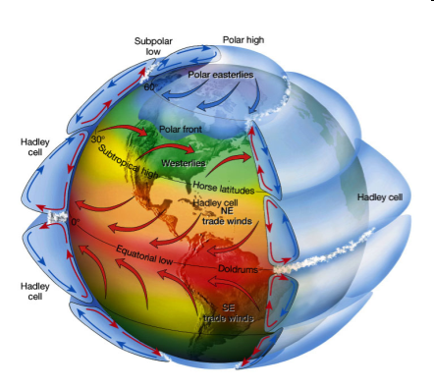
Circulation Cells

Slide 17
Prevailing Winds
Major wind currents that blow in a particular direction
Polar easterlies
In polar regions, blow from east to west
2. Westerlies
In middle latitudes, blow from west to east

Slide 18
Prevailing Winds
3. Trade winds
Near equator, blow from east to west
4. Jet stream
2 in each hemisphere, very high altitude
Used by airline pilots to speed up flight time

Slide 19
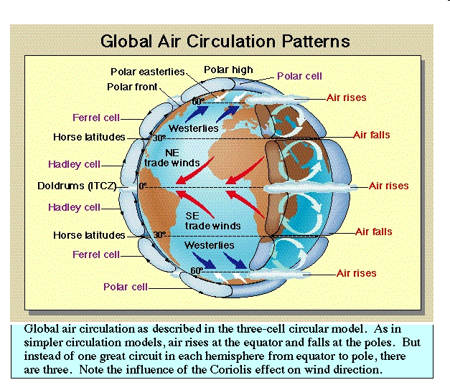

Slide 20
Air Masses
A large area of the atmosphere with a given temperature and humidity
Two air masses meet at a “front”, transition zone where wind direction, temperature and humidity change rapidly

Slide 21
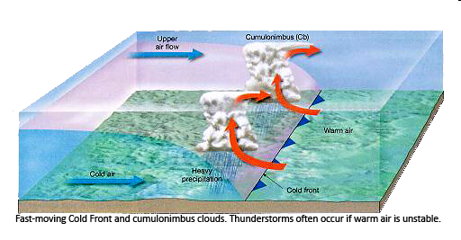
Air Masses
Cold Front
When cold air meets warm air
Warm air rises rapidly and cools forming wind and heavy rain

Slide 22
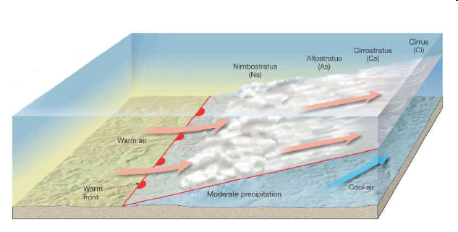
Air Masses
2. Warm Front
When warm air meets cold air
Warm air rises slowly, creates light clouds and dispersed showers

Slide 23
Anticyclones and Depressions
Anticyclone (high pressure system):
An area of atmospheric circulation around a high pressure centre (caused by descending cold air)
Descending cold air prevents cloud formation, this means sunny skies
Air turns clockwise in northern hemisphere, counter clockwise in southern hemisphere

Slide 24
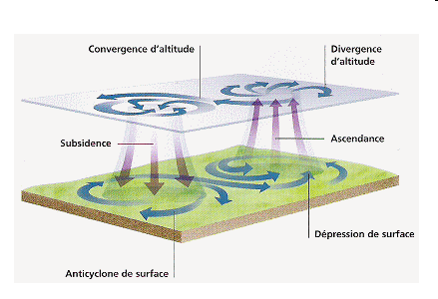
Anticyclone

Slide 25
Anticyclones and Depressions
2. Depression (low pressure system)
An area of atmospheric circulation around a low pressure area (caused by rising warm air, may cause hurricanes)
Rising warm air encourages cloud formation and precipitation
Air turns in counterclockwise in northern hemisphere and clockwise in southern hemisphere

Slide 26
Wind Energy
No emissions, renewable ☺
Disadvantages
Can ruin a landscape, can’t rely on wind, energy can’t be stored
Often used in combination with another power generating system that can take over if wind dimishes

Slide 27
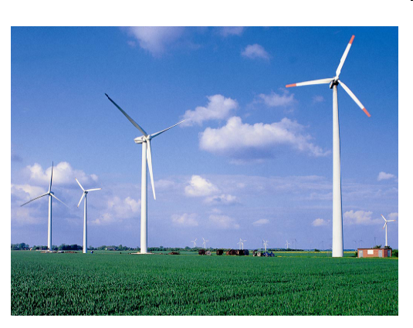

Slide 28
Solar Radiation
Nuclear reactions in the sun to produce energy
Rays heat the atmosphere, oceans and land on Earth
Topical regions receive more solar energy due to curvature of the earth

Slide 29
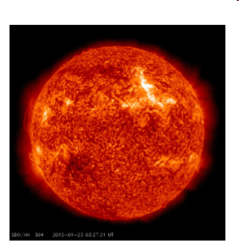
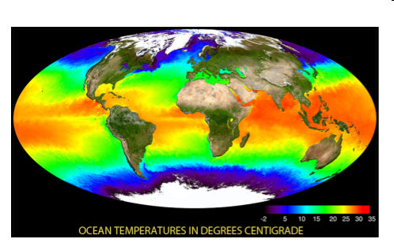

Slide 30
Solar Energy
Earth receives enough solar energy in 1 hour to meet the world’s energy needs for 1 year
Renewable, no emissions, practical for remote areas, can be stored ☺ ☺ ☺
Passive heating systems:
Based on location of building to maximize the sun’s exposure
Use of materials that will store heat and release it slowly overnight

Slide 31
Solar Energy
2. Photovoltaic cells
Placed in large panels (solar panels)
Convert solar energy into electrical energy
3. Solar collectors
Used to heat air in buildings or water in homes or pools
Glass panels capture heat, heat is transferred to water in pipes and then circulates through radiators

Slide 32
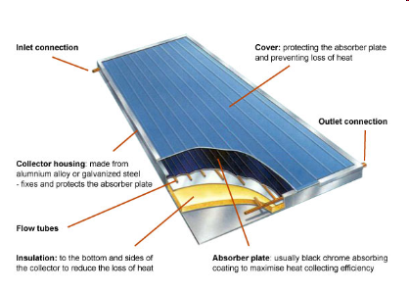
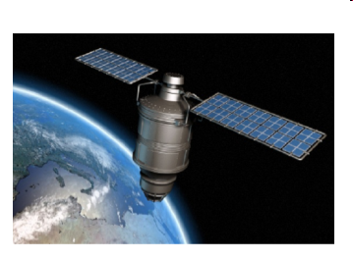

Slide 33
Tides
High and low tides occur due to the attraction to the moon
High tides occurs twice every day to rotation of the Earth
At any one time there are 2 high tides and 2 low tides
When closest to the moon, water is pulled towards it, creating high tides

Slide 34
Tides
When furthest from the moon, Earth is pulled toward the moon more strongly than water, creating high tides as well
Highest tides, called spring tides, occur when the sun, moon and Earth are aligned
The difference between high and low tide is called tidal range

Slide 36
Tidal Energy
Energy obtained from the flow of ocean tides
Renewable, no emissions ☺
but very expensive ☹
Works like a hydroelectric power plant
Tide comes in and fills a basin
Water stays in basin as tide goes out
Gate is opened to release water from basin
Water turns turbines to produce electrical energy

Slide 37
