Slide 1
Changes in Matter-Part 2
All great things have a part 2
-The Godfather
-The Lord of the Rings
-Star Wars
…
And this lecture ☺

Slide 2
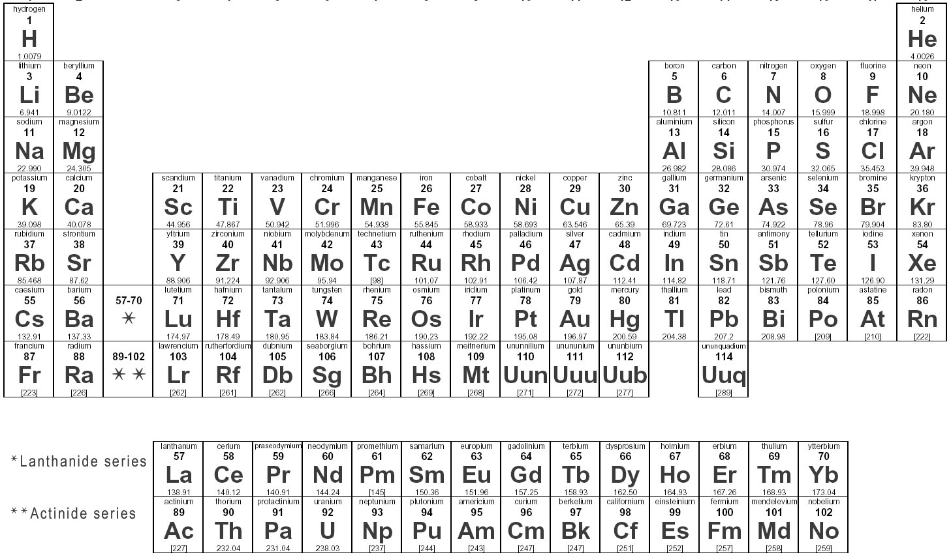

Slide 3
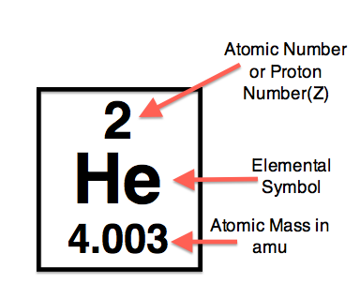
Image of typical Element in Periodic Table
Atomic Number (Z)→ the number of protons. Does not change! Atomic number is unique per element!
Atomic Weight
Atomic Weight → average of the atomic masses of all isotopes of an element with respect to its abundance

Slide 4
Balancing Equ and with masses
Question: You combined 80g of KOH with 100g of H₂SO₄ to produce 120g of K₂SO₄ and H₂O. What is the mass of the water produced?
Step 1: Get a balanced equation

Slide 5
Balancing Equ and with masses
Reactants: KOH and H₂SO₄
Products: K₂SO₄ and H₂O
Equation: KOH + H₂SO₄ → K₂SO₄ + H₂O
-Rnx side: 1K, 3H, 1S and 5O
-Prod side: 2K, 2H, 1S and 5O
2KOH + H₂SO₄ → K₂SO₄ + 2H₂O

Slide 6
Balancing Equ and with masses
Question: You combined 80g of KOH with 100g of H₂SO₄ to produce 120g of K₂SO₄ and H₂O. What is the mass of the water produced?
Step 1: Get a balanced equation
2KOH + H₂SO₄ → K₂SO₄ + 2H₂O
Step 2: Place the weights of the compounds given under the appropriate compounds

Slide 7
Balancing Equ and with masses
2KOH + H₂SO₄ → K₂SO₄ + 2H₂O
80g + 100g → 120g + x
Step 3: Add total weight of reactant side and total weight of product side
Rnx: 180g
Prods:120+x
Recall: Conservation of mass!. Therefore the total weight of the reactants must equal the total weight of the products

Slide 8
Balancing Equ and with masses
2KOH + H₂SO₄ → K₂SO₄ + 2H₂O
80g + 100g → 120g + x
Step 3: Add total weight of reactant side and total weight of product side
Rnx: 180g
Prods:120+x
Step 4: Solve for ‘x’
120+x = 180; x=60g
Weight of water = 60g

Slide 9
Balancing Equ and with masses
Step 1: Balance the equation
If given a balance equation, great, less work ☺
If not given a balance equation…start cracking ☹
Step 2: Write given weights of compounds under appropriate compound
Step 3: Add total weight of reactant side and total weight of product side
Remember, will be solving for either a product or a reactant, so one of the compounds will have a weight of ‘x’
Step 4: Solve for ‘x’

Slide 10
Practice ☺
When 191g of copper (Cu) is combined with 765g of nitric acid (HNO₃), the reaction produces 563g of copper nitrate (Cu(NO₃)₂), 108g of water and a certain amount of nitrogen dioxide (NO₂). What is the mass of nitrogen dioxide produced?
The combustion of 11g of propane (C₃H₈) in 40g of oxygen gas produces 18g of water and a certain mass of carbon dioxide. What is the mass of carbon dioxide produced?

Slide 11
Answers ☺
Question 1
Balanced equation:
Cu + 4HNO₃ → Cu(NO₃)₂ + 2H₂O + 2NO₂
191g 765g 563g 108g x
Reactants → 191 + 756 =947
Products → 563 + 108 + x= 671+x
Mass of 2NO₂
671+x =947
x= 276g

Slide 12
Answers ☺
Question 2
Balanced equation:
C₃H₈ + 5O₂ → 4H₂O + 3CO₂
44g 90g 68g x
Reactants → 44 + 90 = 134g
Products → 68 + x
Mass of 3CO₂
68 + x = 134
x= 66g

Slide 13
Practice! Balance the following equations
Worksheet! ☺ YAY!

