Slide 1
Chapter 6- The Lithosphere and the Hydrosphere

Slide 2
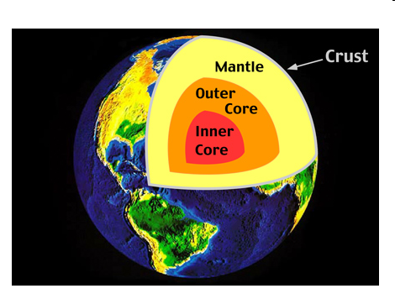
The Lithosphere
Shell of the Earth, consists of crust and upper mantle
Contains minerals and rocks

Slide 3
1. Minerals
Solid, inorganic substances with defined composition and properties
Exists naturally
Made of identical shaped crystals
Classified in 4 ways
1. Colour
a) idiochromatic (always the same colour, red ruby)
b) allochromatic (can take on different colours, quartz)

Slide 4
Minerals
Red Ruby Quartz

Slide 5
Minerals
2. Transparency
Objects can be transparent, translucent or opaque
3. Hardness
Mohs scale, a mineral can scratch anything below it

Slide 6
Moh Hardness Scale

Slide 7
1. Minerals
4. Streak
When rubbed on porcelain, minerals leave a trace of powder
Colour left depends on type

Slide 8
Mining of Minerals
Ore is extracted from the lithosphere (rock containing mineral), then separated

Slide 9
2. Rocks
Heterogeneous solid made of many minerals
Can be used for decoration, building, insulation, etc.
Three types
Igneous
Sedimentary
Metamorphic

Slide 10
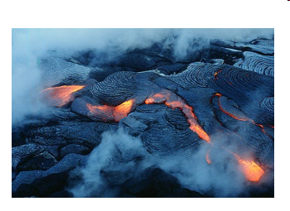
Igneous Rock
Formed when magma cools and solidifies

Slide 11
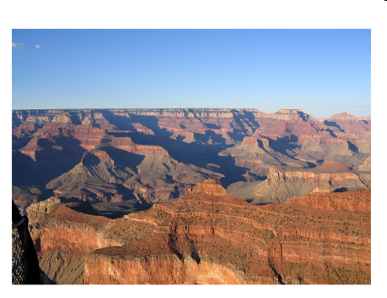
Sedimentary Rock
Formed by accumulation and compression of debris under water, layers

Slide 12
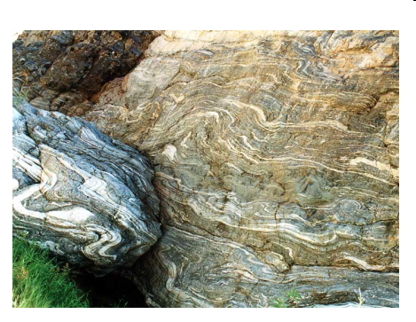
Metamorphic Rock
Igneous or Sedimentary rocks transformed by heat or pressure

Slide 13
3. Soil
Comes from rock that breaks down over time (frost, wind) and decomposing organic matter
200 years to form a layer of soil 1 cm thick!

Slide 14
5 soil horizons (layers)
Organic matter ( decomposing plants and animals)
Topsoil (humus and minerals, supports plant life)
Subsoil (small mineral particles, trees get nutrients here)
Fragmented parent rock (chunks of rock formed from layer below)
Unaltered parent rock (starting point for soil formation)

Slide 15
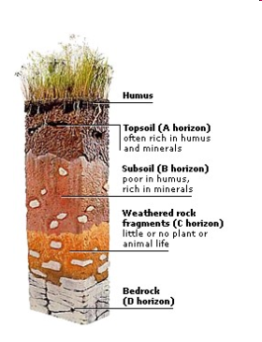
Soil Horizons

Slide 16
Fertility of soil depends on:
Presence of minerals
Adequate moisture
Appropriate pH

Slide 17
4. Sources of Energy in Lithosphere
Fossil Fuels
Result from the transformation of organic matter
Includes coal, natural gas and oil
Natural gas and oil are produced when organisms die, sink to the bottom of oceans and are compressed over time

Slide 18
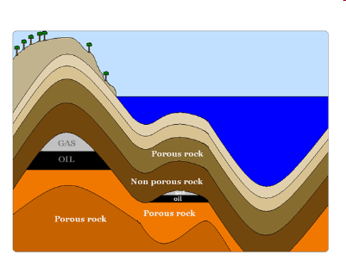
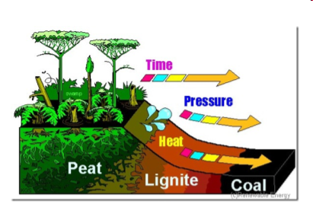
4. Sources of Energy in Lithosphere
Coal is formed from trees that once grew in swamps, over time they were buried and compressed
When fossil fuels are burned, they produce CO2 and CH4

Slide 19
4. Sources of Energy in Lithosphere
b) Uranium
Splitting the atom allows a huge output of energy (one handful provides as much energy as 70 tonnes of coal)
Nuclear reactors needs to cool waste and then bury it
Risk of accidents is a constant concern (radioactivity)

Slide 20
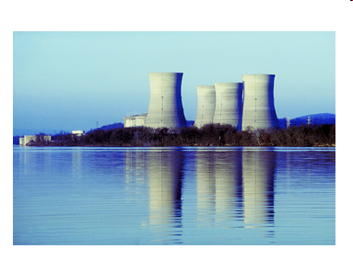
Picture of Nuclear Power Plant

Slide 21
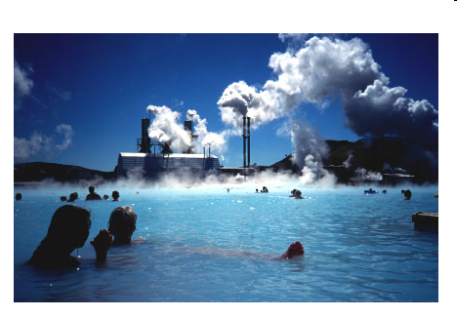
4. Sources of Energy in Lithosphere
c) Geothermal energy
From the internal heat of the Earth
A fluid is circulated deep underground, heated, and then returns to surface
Used mostly in volcanic regions of the world

Slide 22
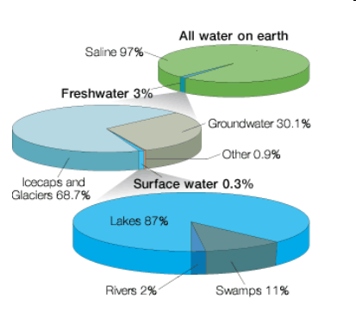
The Hydrosphere
Outer layer of water on Earth, includes liquid, solid and gas forms

Slide 23
1. Inland waters and watersheds
Inland waters are fresh water, includes lakes, rivers and groundwater
Watersheds are areas where inland waters drains into the same larger body of water
Water flow is influenced by topography, geology, climate, vegetation, development
Quebec has 3 watersheds

Slide 24
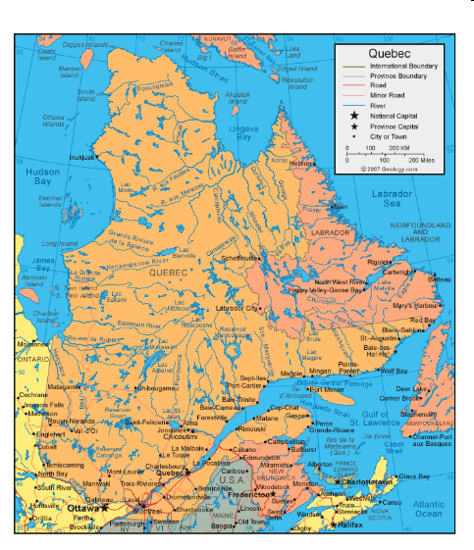

Slide 25
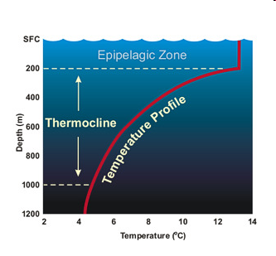
2. Oceans
Pacific, Atlantic, Indian, Artic and Southern Oceans
Water temperature determined by:
Depth: below 200m temperature drops drastically (thermocline zone)
Seasons
Latitude (warmer around equator)

Slide 26
2. Oceans
Ocean circulation is caused by ocean currents
Surface currents are caused by wind, move horizontally
Subsurface currents caused by density and salinity (colder and saltier=more dense)
Thermohaline circulation is the combination of both (conveyor belt responsible for regulating global climate)

Slide 27
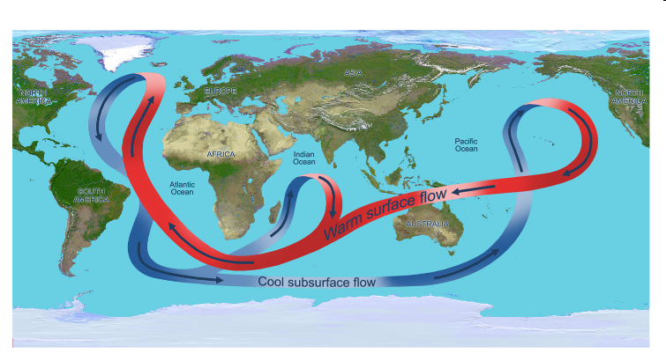
Picture of Ocean Currents

Slide 28
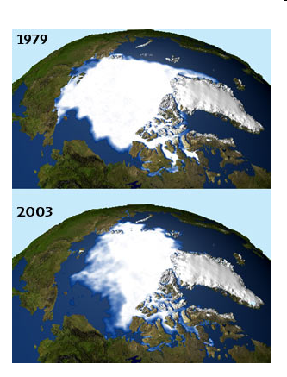
3. The Cryosphere (Frozen Water)
Pack ice is the ice floating on the oceans near the North and South poles
Global warming has caused Arctic ice pack to shrink significantly

Slide 29
3. The Cryosphere (Frozen Water)
Glaciers are masses of ice on land
When chunks break off and fall into the sea they create icebergs
This causes a rise in sea level
When ice melts salinity is affected, water becomes less dense, could have an impact on ocean currents and therefore global climate

Slide 30
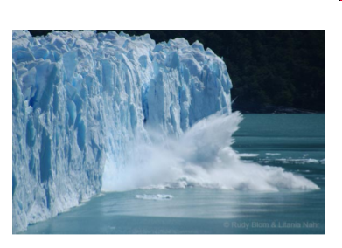
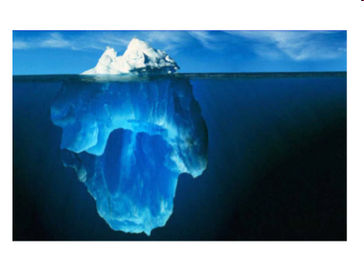
Pictures of Icebergs

Slide 31
4. Energy resources of the Hydrosphere
Hydraulic energy is derived from moving water
In Quebec the energy from the flow in rivers is converted to electrical energy
Renewable, no greenhouse gases emitted, but severe damage to ecosystems
Waves and ocean currents can also be used to transform energy

Slide 32
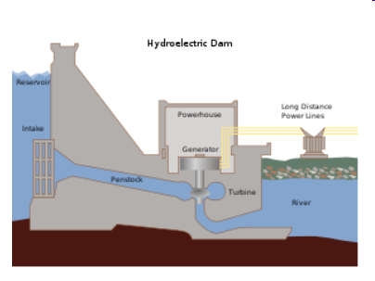
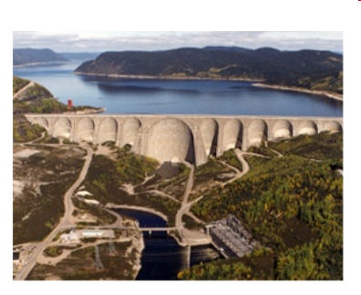
Pictures of Hydroelectric Dams

