Slide 1
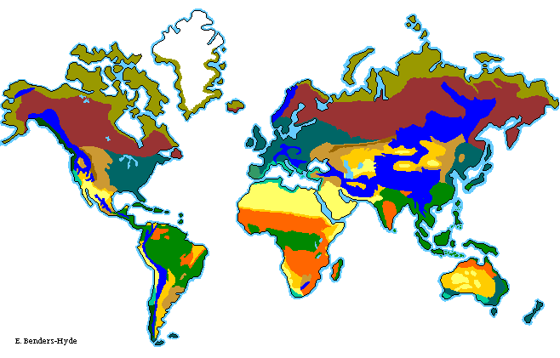
Biomes
Chapter 8, p. 262-279

Slide 2
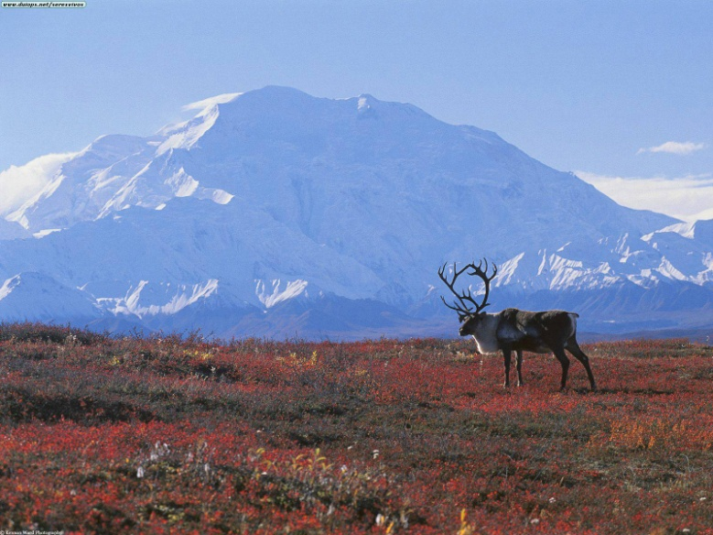
What are Biomes?
Large regions of the world with distinctive climates, wildlife, vegetation
Life in a biome is affected by temperature, precipitation, soil, water, nutrients, etc.

Slide 3
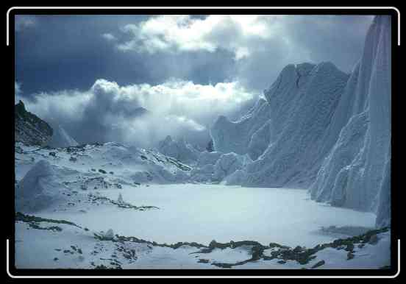
Terrestrial Biomes
Plants and animals living in terrestrial biomes limited by temperature and precipitation
Latitude and altitude also very important

Slide 4
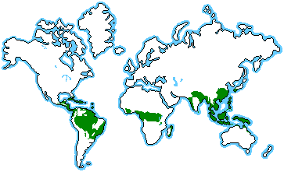
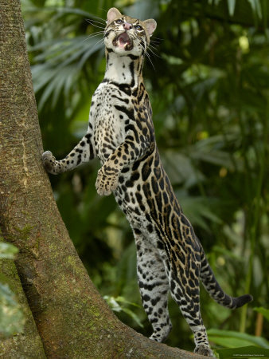
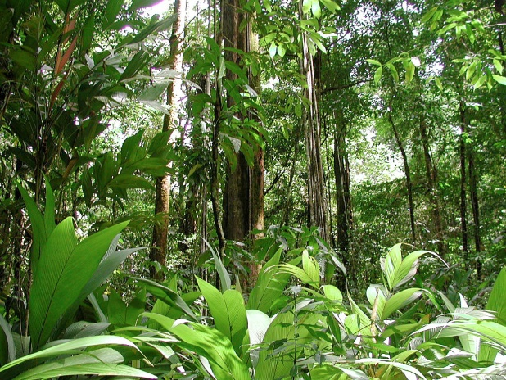
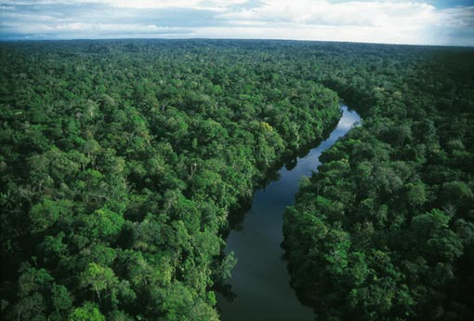
1 - Tropical Forests
Located near equator
Average temperature 20-34 ºC
Occupy less than 10% of Earth’s land mass
Home to 50-80 % of all plant and animal species
At risk due to farming, logging
Critical in regulating global climate

Slide 5
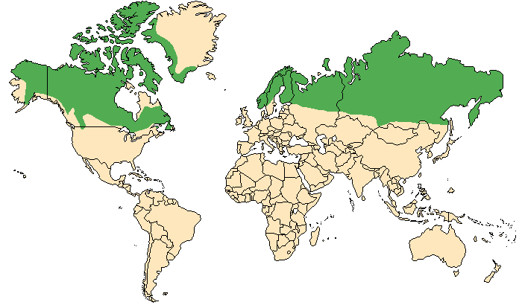
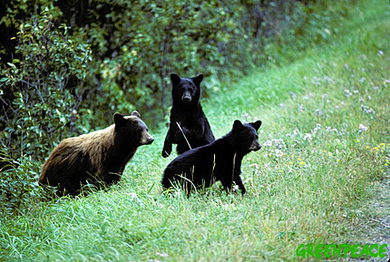
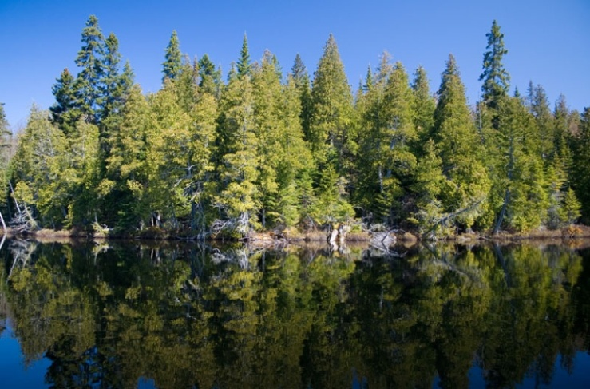
2 – Boreal Forests
Located in northern hemisphere,
cold winters
¼ of forests in world are boreal
Characterize d by lichen, moss, conifers
Many lakes and marshes
Acidic, nutrient-poor soil
Threatened by logging

Slide 6
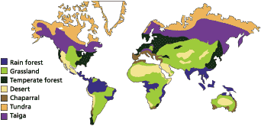
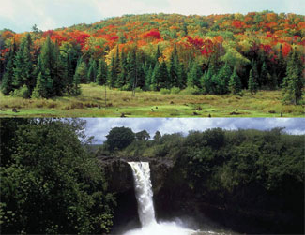
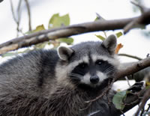
3 – Temperate Forests
Located in southern Canada, U.S., Europe
Characterized by conifers and deciduous trees
Average temperature 8-10 ºC, high precipitation
Nutrient rich soil
Threatened by farming

Slide 7
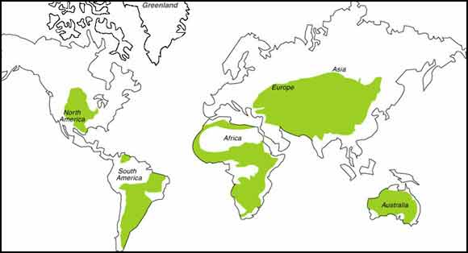
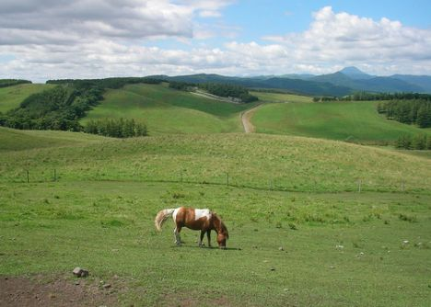
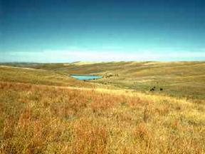
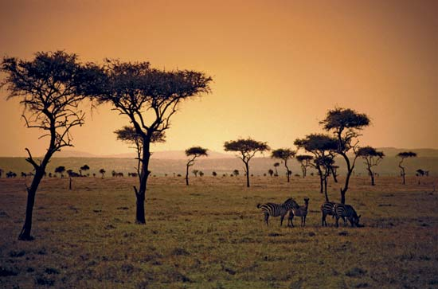
4–Grasslands and Shrublands
Very resistant to fire, drought, mowing, grazing
Not enough rain for trees, too much for desertification
3 main types:
Temperate grasslands, hot summers, cold winters
Savannas, hot all year
Derived grasslands, prairie converted into farmland

Slide 8
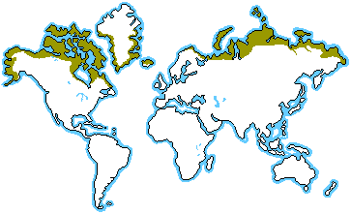
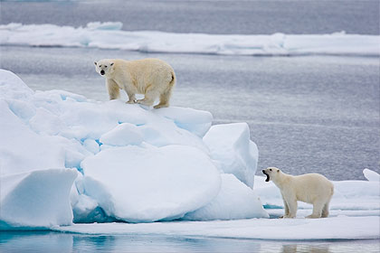
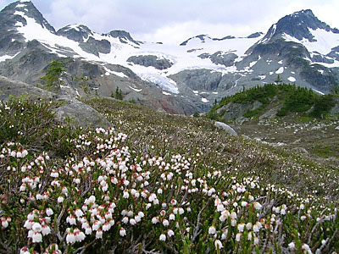
5 – Arctic Tundra
Located around North Pole
Covers 6% Earth’s land mass
Characterized by grasses, stunted bushes, moss, lichen
Ground never thaws, permafrost
Many migratory birds spend the summer
Threatened by rising global temperatures

Slide 9
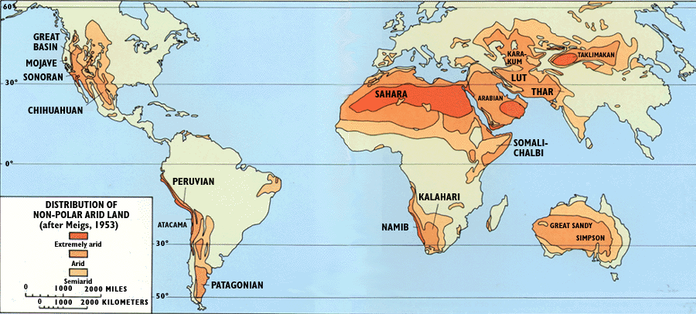
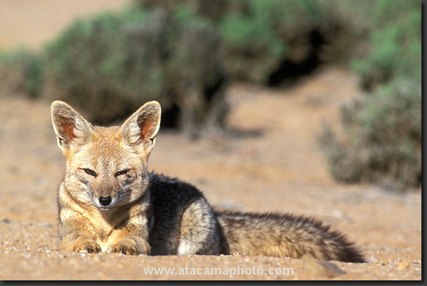
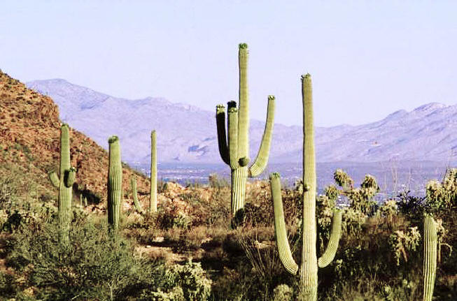
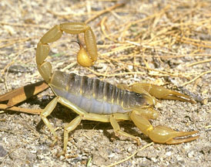
6 - Deserts
Cover 1/3 or Earth’s land mass
Low precipitation (less than 25 cm/yr)
Extreme temperatures
Very few animals and plants
Hot deserts experience drastic temperature changes
(no clouds, water to maintain heat)

Slide 10
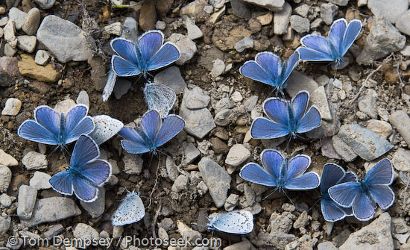
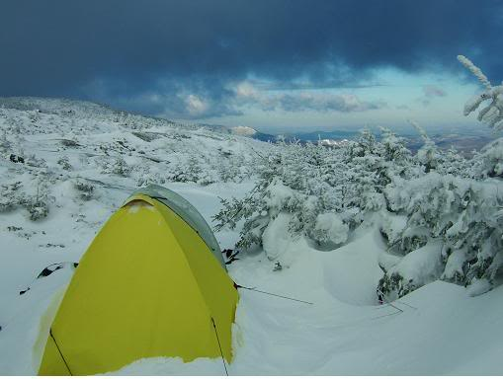
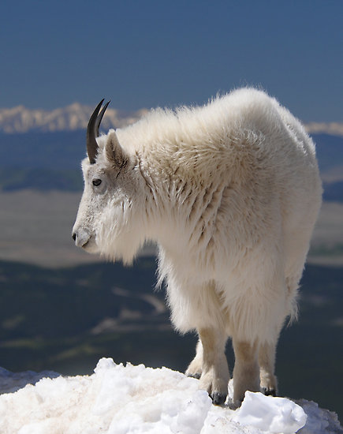
7 - Alpine
Defined by altitude, located all over world
Temperature drops 0.6 ºC/ 100 m
5 zones:
Submontane: below 1300m, people, plants, animals
Montane: 1300-1800m, mostly conifers, 8-15 ºC
Subalpine: 1800-2400m, highest zone for trees
Alpine: 2400-3000m, no trees, extremely cold
Nival: above 3000m, snow caps, almost no vegetation

Slide 11
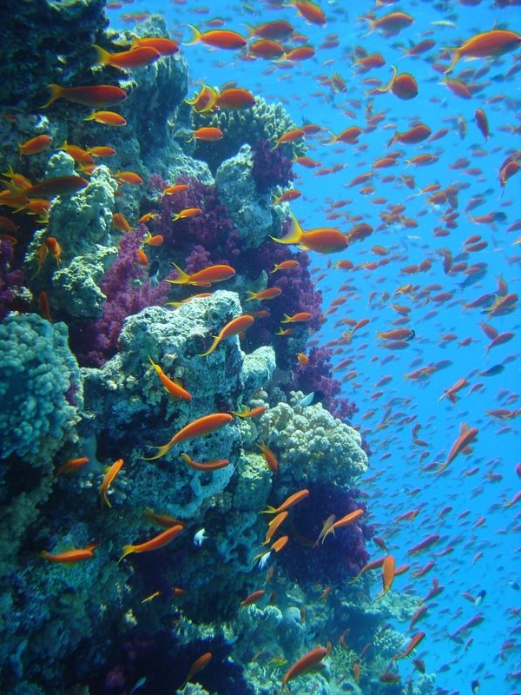
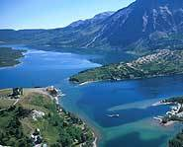
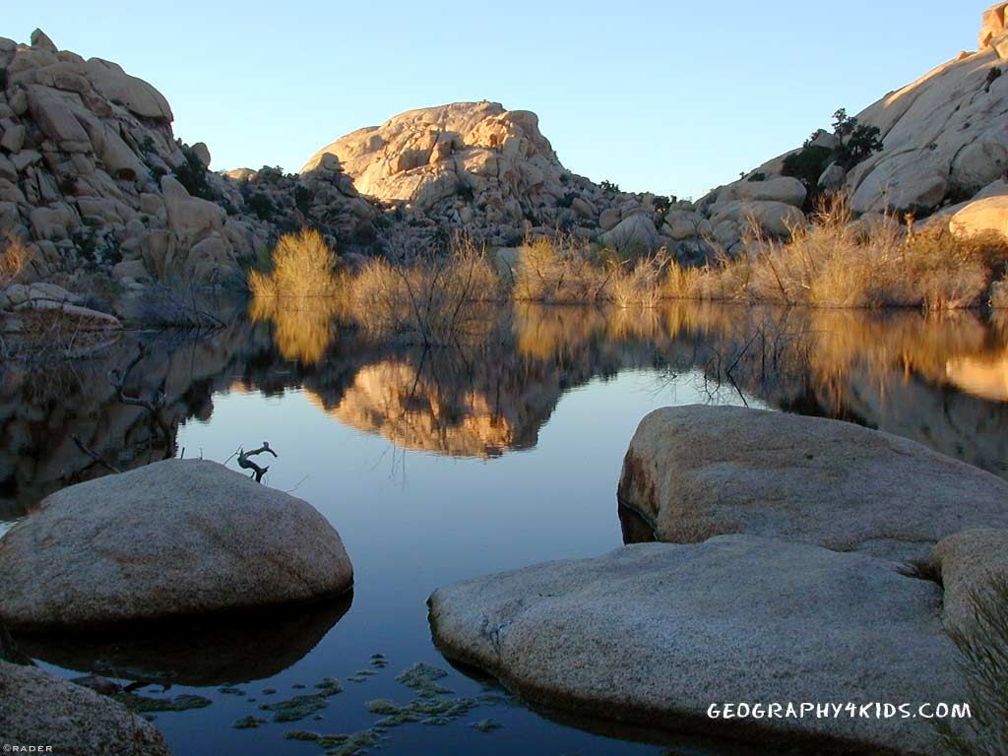
Aquatic Biomes
Cover 75% of Earth’s surface
Not limited by latitude or altitude, can exist almost anywhere
Fresh water biomes more likely in areas of high precipitation
2 types:
Fresh water, salinity ≤ 0.05 %
Marine, salinity ≥ 3%

Slide 12
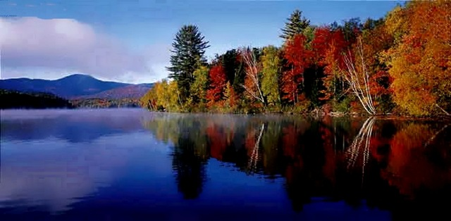
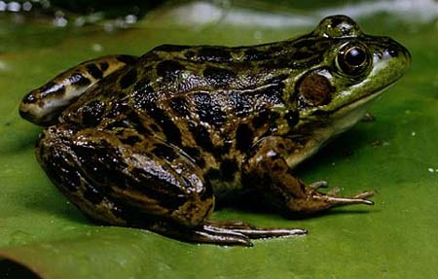
1 - Lakes
Surrounded by land, fed by springs, rivers or rain
Microorganisms, plants, plankton, fish, amphibians, reptiles, birds
Lake shore vegetation offers habitat and acts as filter for runoff water

Slide 13
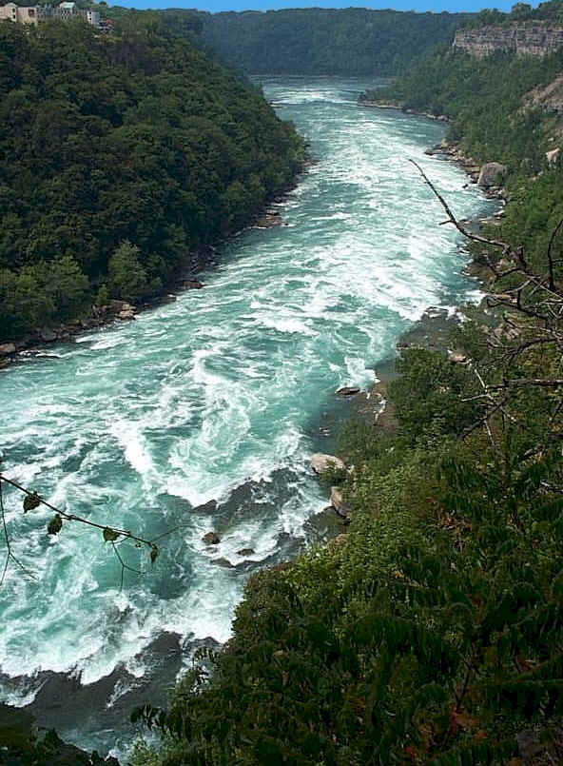
2 - Rivers
Drainage channels for surface water
Plants highly adapted to current and high O2
In Quebec, water quality compromised by industry and agriculture
2002, Quebec adopted policy to protect watersheds

Slide 14
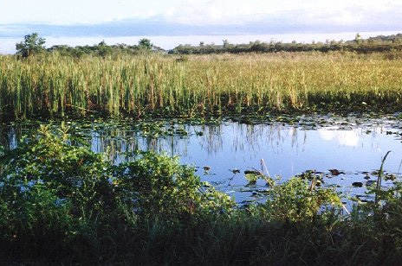
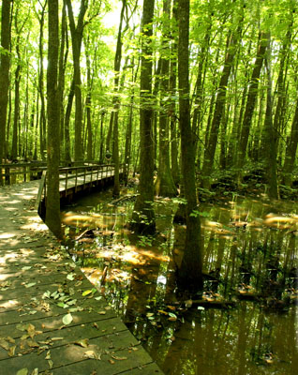
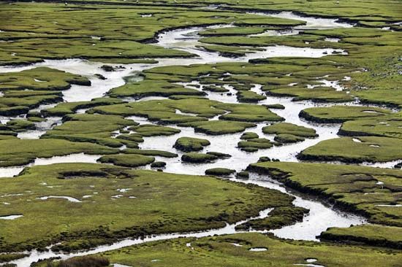
3 - Wetlands
Areas permanently or temporarily covered in water
Can be fresh or salt water
9% of Quebec, 14% Canada covered in wetlands
Home to many species
Act as sponge for rain, reduce flooding
3 types:
Marshes: stagnant water, no trees
Swamps: stagnant or slow moving water, trees
Peat bogs: poorly drained soil, covered in moss

Slide 15
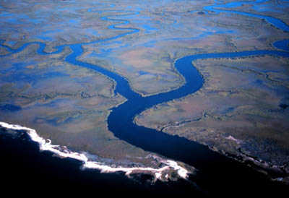
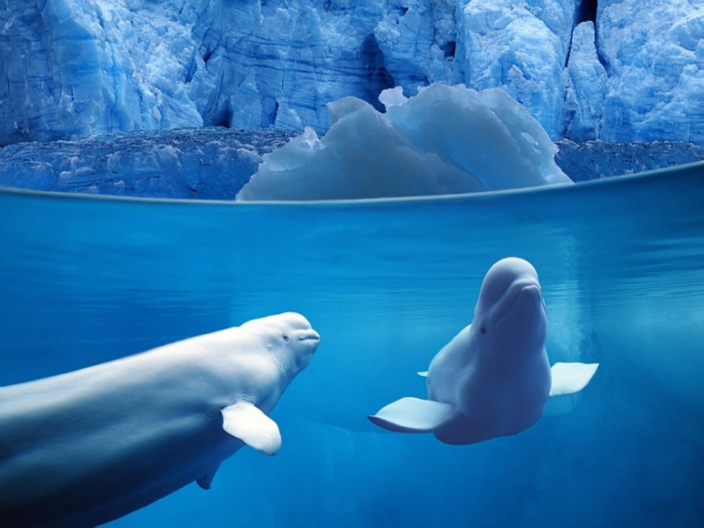
1 - Estuaries
Where rivers widen before reaching the sea
From Latin “aestus” for tide
Fresh water mixes with salt water
Lots of sedimentation, turbid water
Freshwater marine organims

Slide 16
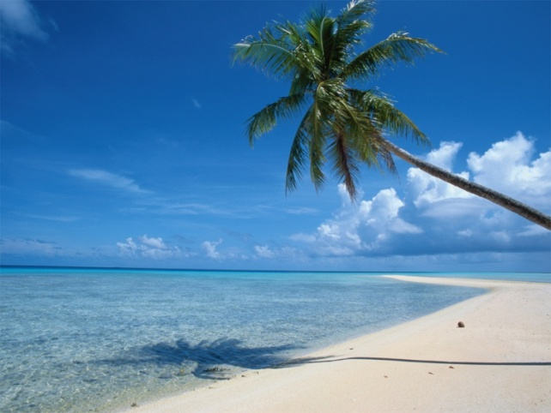
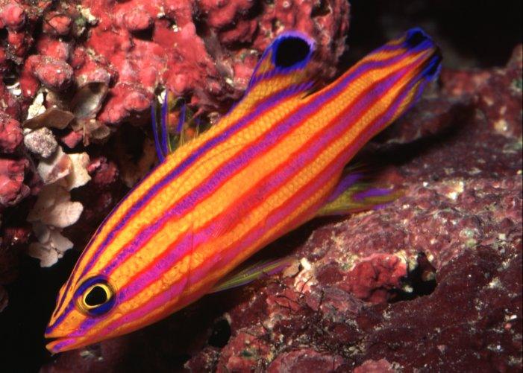
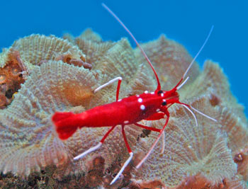
2 – Oceans and Seas
Species that live at surface depend on phytoplankton
Have little protection from predators
“Benthos” live on or in the sea bed, feed on dead organisms (mollusks, crustaceans, deep water fish)
Fishing is large threat, 80% done near coast

Slide 17
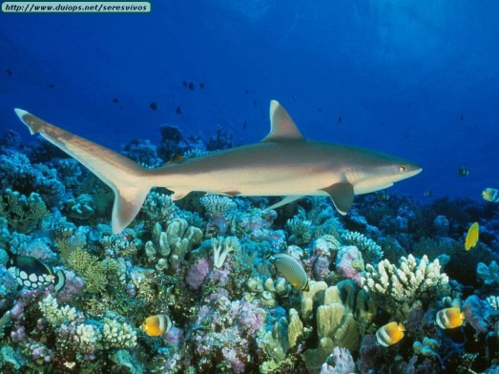
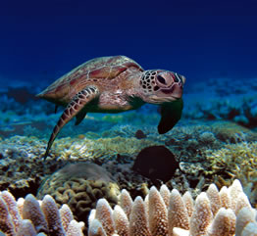
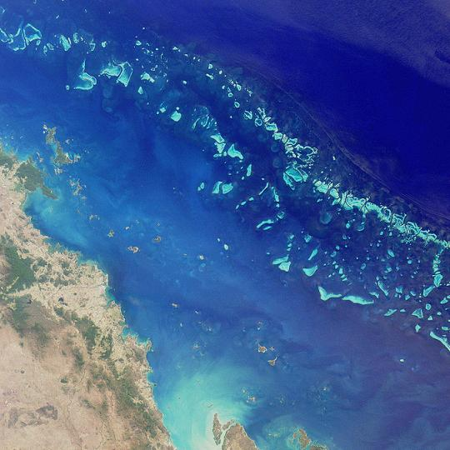
3 – Coral Reefs
Very rich biodiversity
Reefs are alive, corals are invetebrates
Most found in tropical seas
Corals produce calcium carbonate, forms reefs
20% or Earth’s reefs have been destroyed by pollution, over fishing, global warming
Great Barrier Reef in Australia is over 2000 km long, can be seen from space!

