Slide 1
Populations
Chapter 9
p.292

Slide 2
What is a population?
Group of individuals of the same species living in a shared space
3 main characteristics:
Population size
Population density
Population distribution

Slide 3
Population Size
The # of individuals in a population
Affected by:
Births
Deaths
Immigration (arrivals)
Emigration (departures)
When births + immigration = deaths + emigration
population size is stable (p.294)

Slide 4
Calculating Population Size
Count individuals in random sample area, then estimate by calculation
Example:
You count 150 dandelions in a 1 m² patch on your lawn. If your lawn is 1000 m², what is the total population size?
150 dandelions = ? dandelions
1 m² 1000 m²
Your population size = 150 000 dandelions

Slide 5
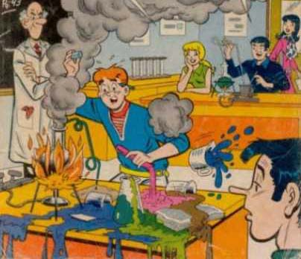
Population Density
# of individuals per unit of area or volume
Affected by access to resources, climate, parasites, disease, natural disasters
Population density = # individuals
space occupied
Example: There are 32 people in this room which has an area of 70 m². What is the population density?
32 people = 0.46 people/ m²
70 m²

Slide 6
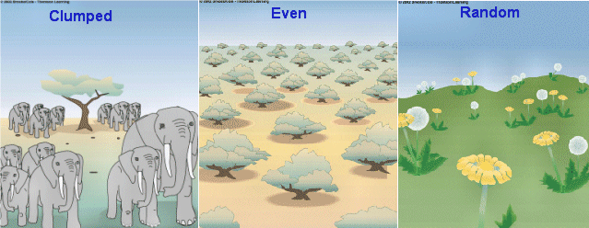
Population Distribution
The way in which individuals are dispersed in their habitat
Three types:
Clumped: most common, groups, seen when certain areas offer better conditions than others
Uniform: dispersed equally, due to competition
Random: rare, unpredictable, seen with plants

Slide 7
Ecological factors affecting population density
An aspect of a habitat that affects organisms living there
Examples are food, predators, temperature, precipitation
2 main types:
Abiotic (non-living), physical or chemical aspects of a habitat
Biotic (living), predators, competition, etc.
Examples on p.300

Slide 8
Limiting Factors
An ecological factor that causes the density of a population to decrease
Can be absent, in excess, present but insufficient
For example:
Sunlight, too little limits photosynthesis (absence)
Water, too much can cause plant roots to rot (excess)
Emigration, for example some frogs leave a pond after a toxic spill, predator population decreases (insufficient)

Slide 9
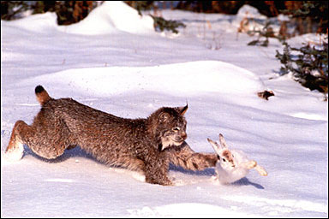
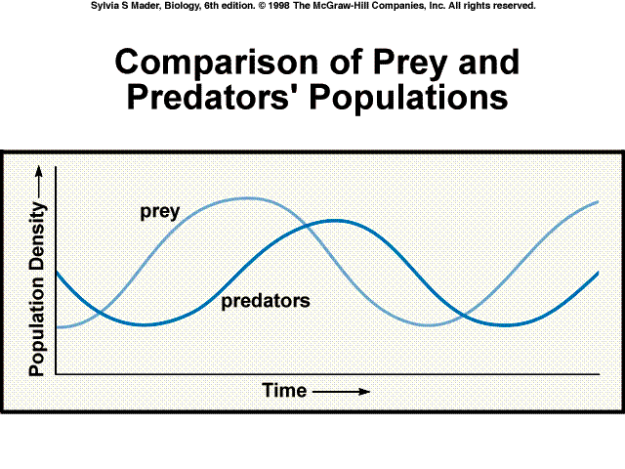
Biological Cycles
Alternating periods of increase and decrease in population size
Fixed duration, continually repeating
Example: The lynx and the hare in Quebec.
As hare pop. , lynx pop.
As lynx pop. , hare pop.
As hare pop. , lynx pop.
As lynx pop , hare pop.

Slide 10
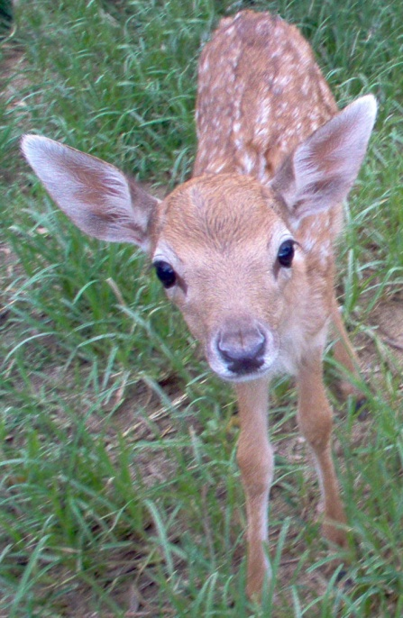
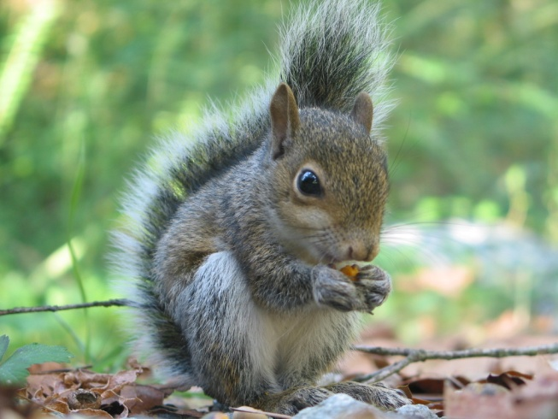
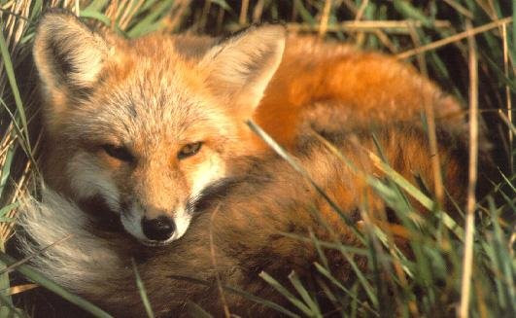
Communities
A set of populations of different species sharing the same habitat
For example, Quebec forests:
Shared by squirrels, deer, foxes, trees, etc.

Slide 11
Biodiversity
The variety of species living in a community
Two key factors:
Species richness (# of species in a community)
Relative abundance (# of individuals of one species in relation to total # in community)
Biodiversity is high if:
Species richness is high
Relative abundance of different species is similar

Slide 12
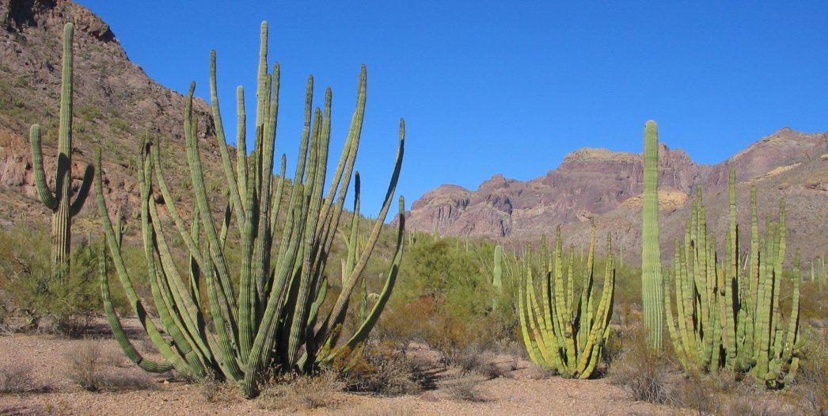
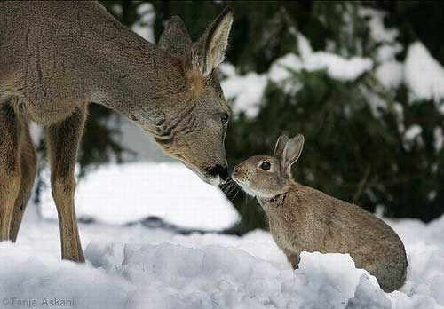
Interaction in a Community
Competition:
Competing for access to resources
Two types:
Intraspecific, between individuals of same species
Interspecific, between individuals of different species

Slide 13
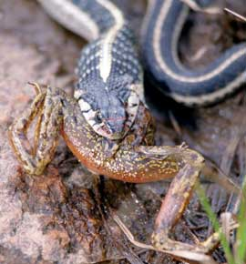
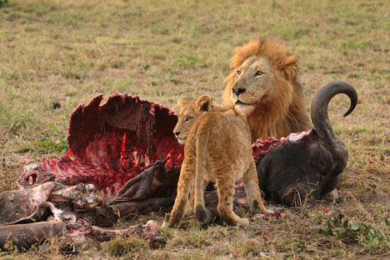
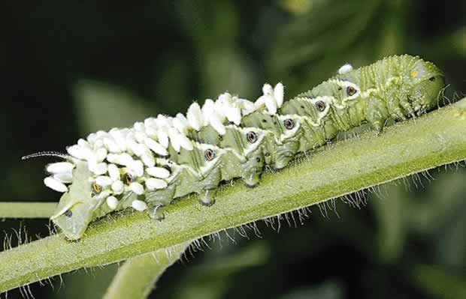
Predation
Interaction between 2 organisms, one feeds on the other
Parasitism is a type, parasite lives on or in its host

Slide 14
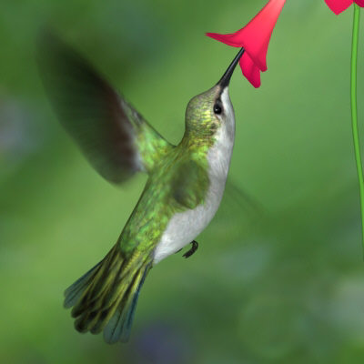
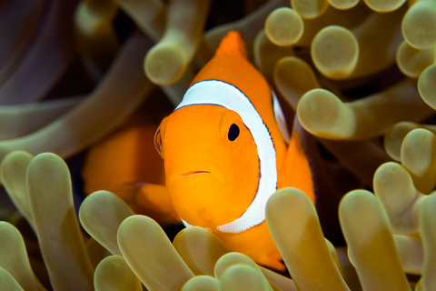
Mutualism
Interaction where both organisms benefit
Finding Nemo: clown fish uses anemone as shelter, attracts prey to anemone
Flowering plants and humming birds: reproduction by pollination, pollinators feed on nectar

Slide 15
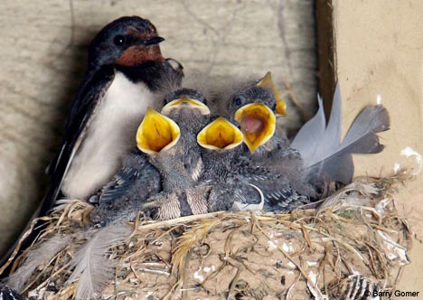
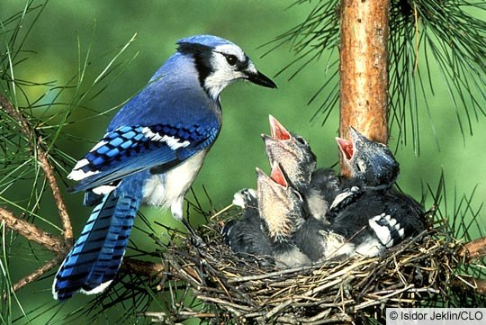
Commensalism:
Interaction where one organism benefits and the other is unharmed
Birds nesting in trees, other animals using abandoned nests

Slide 16
Effect of interaction on population density
Type Effect on Pop. A Effect on Pop. B
Competition
Predation
Mutualism
Commensalism

