Slide 1
Electricity!
It’s electrifying!

Slide 2
What‘s Electricity?
Def: it is the phenomena caused by positive and negative charges
There are two types of electricity
Static electricity → deals with the imbalance of electrical charges at rest
Dynamic electricity → deals with the motion of negative charges carried by electrons

Slide 3
Before we discuss Static and Dynamic…
Atom Review!
The atom is composed of three fundamental particles
Protons which carry a positive charge
Electrons which carry a negative charge
Neutrons which carry no charge
In electricity, we care about protons and electrons due to their charges!
It’s the electrons that can leave the atom! (this is important!)

Slide 4
Charges, charges, charges
A positively charged body is something that has fewer electrons than protons, so it has an overall positive net charge
A negatively charged body is something that has more electrons than protons, so it has an overall negative net charge
A proton and electron has a elementary charge of 1.602 x 10⁻¹⁹ C
A proton would be + 1.602 x 10⁻¹⁹ C
An electron would be - 1.602 x 10⁻¹⁹ C

Slide 5
Static Electricity
Deals with the electrical phenomena with non-moving charges, where electrically charged object have an imbalance of charges
This imbalance can be an imbalance of positive charges or an imbalance of negative charges
Key thing with static electricity, is that charged objects don’t stay permanently charged!
Can loose it very quickly, or gradually

Slide 6
Static Electricity-Loosing charge
Two ways charged objects loose charge
Naturally (i.e. nothing prompted it to loose it, just wore off)
Electrostatic discharge → a negatively charged object touches/comes in close contact a positively charged object
When you “shock” someone, this is what is happening! Electrons from the negatively charged object pass through the air to the positively charged object, rendering both object to have a net neutral charge
When the objects loose their charge, they are “neutral”

Slide 7
Static Electricity-Charging an object
Three ways to charge an object
Friction → rubbing two neutral objects together
Conduction → putting a neutral object in direct contact with a charged object
Induction → putting a charged object near a neutral object without physically touching it

Slide 8
Friction
Rubbing of two neutral bodies
The atoms in one of the substances will pull electrons away from the other
As a result, you will have one body that will become negatively charged (one that take electrons) and another which will become positively charged
Which will become positively and negatively charged depends on the materials!

Slide 9
Friction tendency chart
Tendency | Substance
High affinity to capture electrons (Take on Negative charge) Strong tendency to give electrons (Take on Positive charge) | Plastic Sulpher Gold Nickel, copper Hard rubber Wood, yellow amber, resin Cotton Paper Silk Lead Wool Glass

Slide 10
Friction
Plastic rod rubbed with wool
Plastic pulls some electrons from wool, so plastic becomes negative and wool become positive
Glass rod rubbed with wool
Wool pulls some electrons from glass, so wool becomes negative and glass becomes positive
Plastic rod rubbed with silk
Plastic pulls some electrons from silk, so plastic becomes negative and silk becomes positive
Glass rod rubbed with silk
Silk pulls some electrons from glass, so silk becomes negative and glass becomes positive
Key: what gets what charge depends on what has a higher tendency to give up electrons!

Slide 11
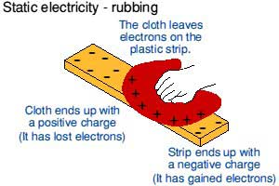
Friction

Slide 12
Conduction
Physical touch of one charged body with a neutral body
The charges from the charged body flow to the neutral body, thus sharing the charges between them
As a result, get two bodies with the same charge

Slide 13
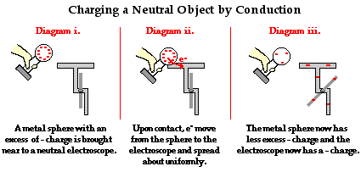
Conduction

Slide 14
Induction
Charging a neutral body without physically touching it!
When you bring a charged object towards a neutral object, the opposite charges of your charged object will begin to accumulate (remember, opposite attract ☺ )

Slide 15
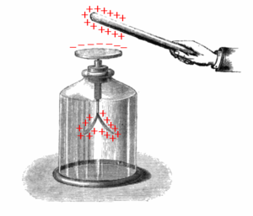
Induction

Slide 16
Attraction and Repulsion between charged bodies
Just like in magnetism, statically charged bodies have attractive and repulsive forces between each other
Like charges repel each other
Opposite charges attract each other

Slide 17
Attraction between two statically charged bodies
+
-

Slide 18
Repulsion between two statically charged bodies
+
+

Slide 19
Dynamic Electricity
Def: electricity caused by the flow of electric charges
A.k.a → dynamic electricity is the electricity you get in wires! (Powering everything you can think of: cell phones, computers, etc.)

Slide 20
Conductors vs. Insulators
Conductors: Substances that allow electricity to flow through them easily
These substances contain free electrons (electrons that are weakly attracted to nucleus) that move from atom to atom → generating electricity
Insulators: Substances that do not allow electricity to flow through them easily

Slide 21
Conductors and Insulators
Substance | Conductor | Insulator
Air |  | ☺
Rubber |  | ☺
Copper | ☺
Aluminum | ☺
Porcelain |  | ☺
Glass |  | ☺
Wood |  | ☺
Iron | ☺

Slide 22
Current Intensity
Def: The rate of the flow of electrons through a medium
The number of electrons going by a particular point every second
The flow of electric charge through a medium
How fast the electrons are moving (Speed!)
Unit: Amperes (A)
A circuit with a current intensity of 9A has electrons moving faster than a circuit with a current intensity of 4A

Slide 23
4 factors affecting Conductance (current intensity)
Thickness (diameter of wire)
The thicker the wire, the higher the conductance
Length
The longer the wire, the lower the conductance
Type/what material wire is made from
Best in order of conductance: Silver, Copper, Aluminum, Bronze and Steel
Temperature
The higher the temperature, the lower the conductance
Fat, short, silver and cold! → Best combo for conductance

Slide 24
Potential Difference
Def: The difference in electric potential energy per unit charge between two points
It’s the work needed to move a charge (electron) from point A to point B in a circuit
It’s the “energy” the electrons have
The amount of energy transferred between two points in an electrical circuit
Unit: Voltage (V)

Slide 25
Resistance
The measure of opposition to the flow of electrons in a medium/circuit
How much something is slowing down the speed of electrons
Force that slows down the flow of current
Think of a hurdle race; the hurdles slow down the speed of the runners so that they aren’t running at their top speed
Unit: Ohms (Ω)
R= V/I
Is the exact opposite of conductance!

Slide 26
Conductance
The ease at which an electric current passes through a medium/circuit
High conductance means low resistance!
Unit: Siemens (S)
G=I/V
Since Conductance is the opposite of resistance
R=1/G
You know one, you can easily solve for the other!

Slide 27
Ohm’s Law
A Very Important Rule
V=I x R R= V/ I
Where V= potential difference (in V)
I= current intensity (in A)
R= resistance (in Ω)
For a given resistance, the potential difference is proportional to current intensity!

Slide 28
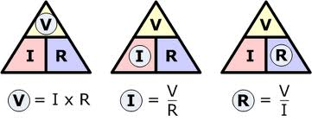
Ohm’s Law triangle

Slide 29
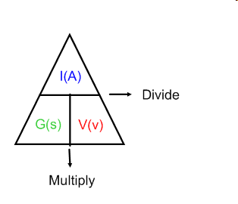
Conductance Triangle
Remember! Conductance is equal to G= 1/V! It is the inverse of resistance, so the position of I and V on the triangle are swapped! V is on the bottom and I is on the top!!!!

Slide 30
Recall on how to read a the triangles
You cover the letter that you are trying to solve
The position of where the remaining letters is the equation
If you are solving for potential difference, you cover the V. I and R are both on the same level, so you multiply them
If you are solving for resistance, you cover the R. V is on top of I, so you divide V by I

Slide 31
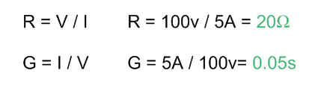
Convert mA to A (Divide by 1000)
50mA/1000 = 0.05A

Slide 34
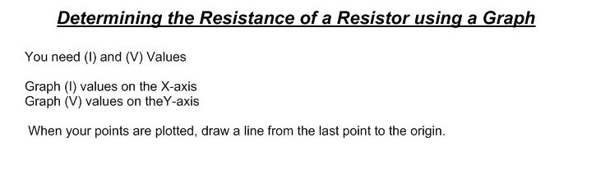
Current (I) | 1A | 2A | 3A | 4A
Potential Difference (V) | 2V | 4V | 6V | 8V

Slide 35
Current (I) | 1A | 2A | 3A | 4A
Potential Difference (V) | 2V | 4V | 6V | 8V

Slide 36
Circuit Diagrams
An electric circuit is a path for the flow of electricity
Made up of
Power supply: provide electric current (I)
Connecting wires
Elements: provides resistance
Fuses/breakers: provides protection
Switches: provides control (to turn on/off system)
Instruments using and/or measuring electricity

Slide 37
Circuit Diagram symbols
Power Supply
Fuse

Slide 38
Series Circuit

Slide 39
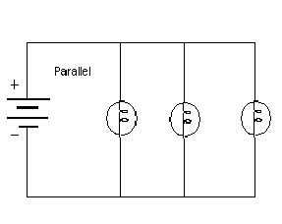
Parallel Circuit

Slide 40
Series vs Parallel
Series
Components are connected end to end
Currents flows in only one path
One defective component stops the charges from flowing
More resistance = less current = less power = less energy

Slide 41
Series vs Parallel
Parallel
Contains at least one branch and contains nodes
Place where current splits to different paths and merges back
Defective components only affect current flow on the pathway it is on, not the entire circuit
Resistance is shared by all paths
Less resistance = more current = more power = more energy

Slide 42
How to measure Potential Difference and Current Intensity
Machines attached to your circuit!
An ammeter measure current intensity!
An voltmeter measures potential difference!
Unit: A (ampere)
Unit: V (volts)

Slide 43
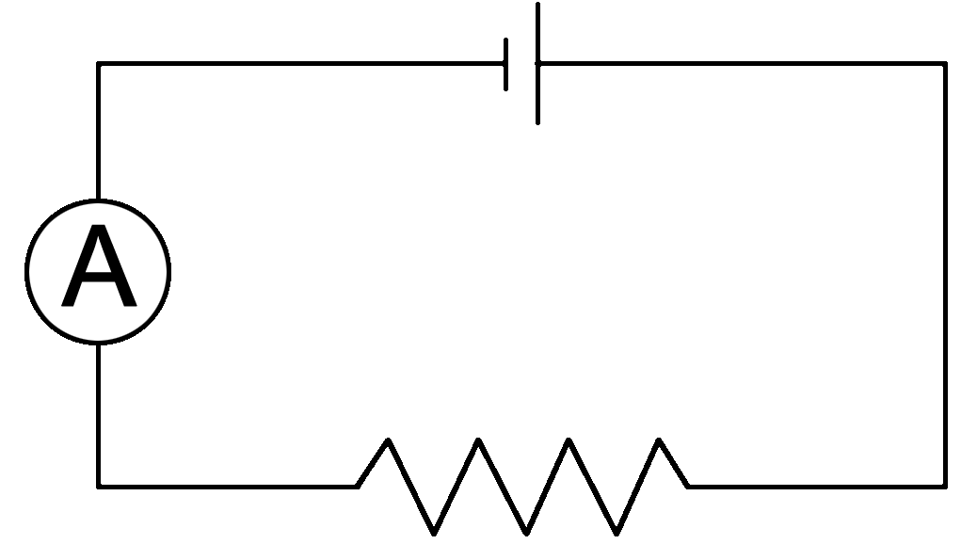
How to connect these things!
An ammeter needs to be connected in series
Meaning it is on the main line

Slide 44
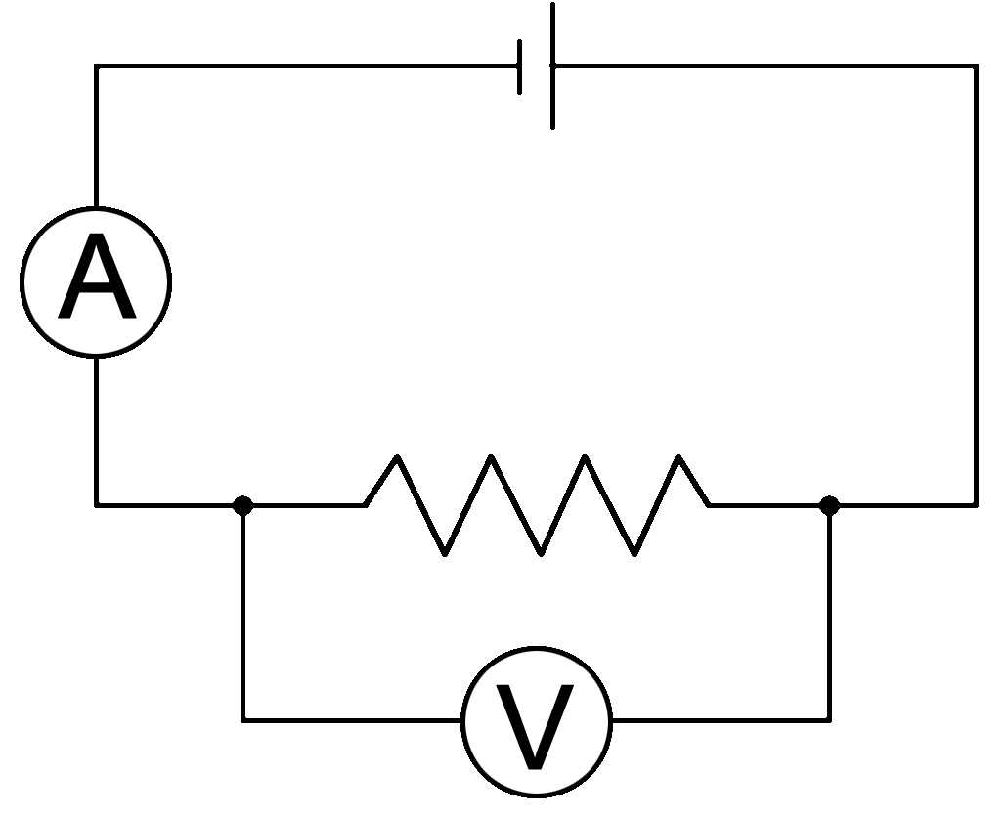
How to connect these things!
An voltmeter needs to be connected in parallel
Meaning it is on its own circuit!

Slide 45
Power
Def: The amount of work an electrical device can perform per unit time.
The more powerful the divide, the faster it works!
Unit : Watts (W)*
P=VxI
P= Power (W)
V=Potential Difference (V)
I= Current Intensity (I)

Slide 46
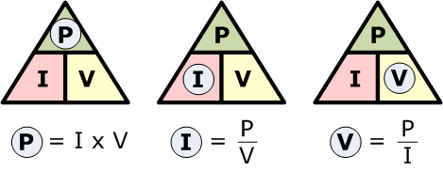
Power!

Slide 47
Energy!
Simply, energy is power multiplied by the period of time
i.e. the energy your iPod consumes is the power times how long it’s on
E=PΔt
There is two possible units for energy
Joules (J)
Kilowatt hours (kwh)

Slide 48
Energy
If your energy is in joules (J), your power must be in watts (W) and your time in seconds (s)
If your energy is in kilojoules (kJ), your power must be in kilowatts (KW) and your time in seconds (s)
Your answer is just going to be smaller than a factor of 1000!
If your energy is in kilowatt hours (kWh), your power must be in kilowatts (KW) and your time in hours (h)
NOTE!!!!
1KW is 1000W
1 hour is 3600 seconds!

Slide 49
Multiply by 3600 (60*60)
Hours
Minutes
Seconds
Multiply by 60
Multiply by 60
Divide by 60
Divide by 60
Divide by 3600 (60*60)

Slide 50
Kilowatts
Watts
Multiply by 1000
Divide by 1000

Slide 51
Kilojoules
Joules
Multiply by 1000
Divide by 1000

Slide 52
Multiply by 1000 (to convert KW to W) then multiply by 3600 (to convert h to s)
Kilowatt hours
Joules
Divide by 1000 (to convert W to KW) then divide by 3600 (to convert s to h)

Slide 53
