Slide 1
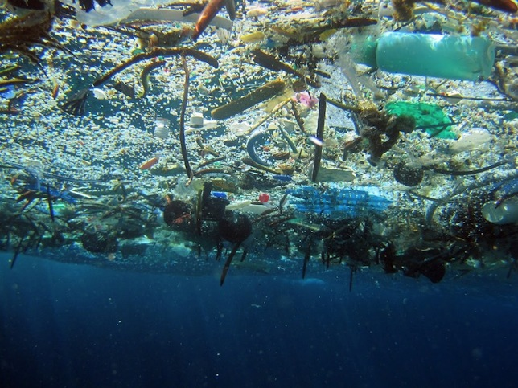
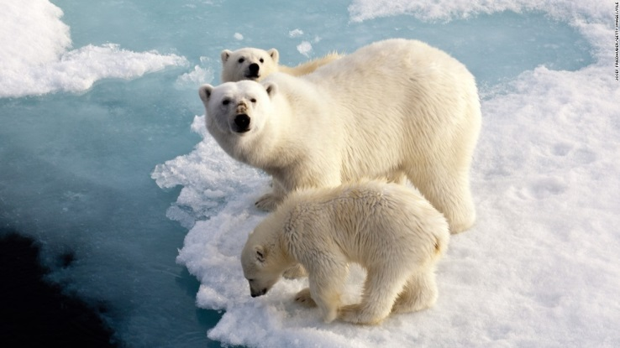
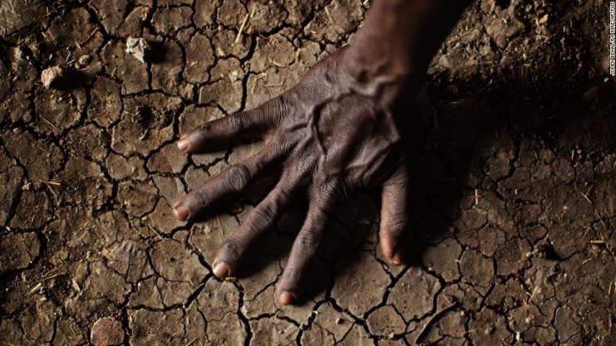
Environmental Challenges
http://www.cnn.com/2014/09/24/world/gallery/climate-change-impact/ (Above Right) http://www.mnn.com/earth-matters/wilderness-resources/blogs/want-to-see-an-ocean-garbage-patch-in-person (Above Left)

Slide 2
The Great Ocean Garbage Patches
What kind of trash is the most dangerous to ocean life of all kinds? A) Driftwood (planks, tree debris, furniture) B) Plastic (bottles, can rings, bags)
C) Glass (bottles, shards) D) Food Waste (banana peels, bones)
E) Paper (cartons, cardboard, newsprint)
http://www.mnn.com/earth-matters/wilderness-resources/blogs/want-to-see-an-ocean-garbage-patch-in-person (Above)

Slide 3
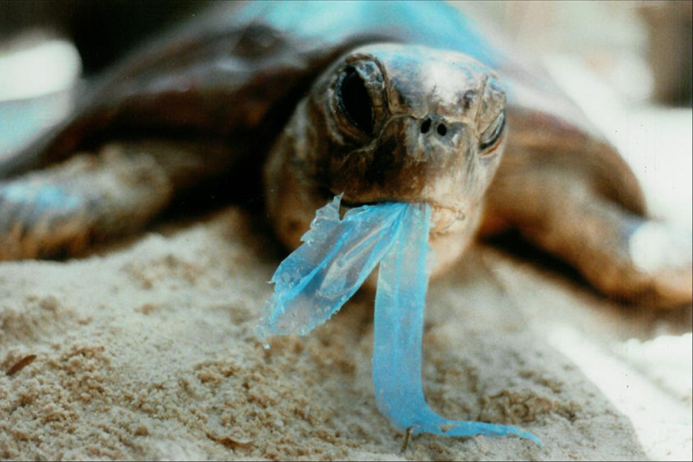
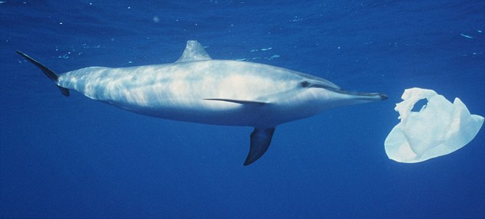
The Great Ocean Garbage Patches
B) Plastic (bottles, can rings, bags)
-Some animals mistake bags for food such as jellyfish
-Mammals and reptiles can choke to death or drown if trapped in plastic garbage
-Plastic degrades very slowly and even very tiny pieces of plastic can harm animals
http://www.abc.net.au/worldtoday/content/2012/s3418575.htm (Turtle Above) http://www.dailymail.co.uk/news/article-2768849/A-planet-drowning-plastic-A-floating-Pacific-garbage-patch-size-Wales-Seabirds-whales-dying-horrible-deaths-How-addiction-plastic-turning-oceans-toxic.html (Dolphin Above)

Slide 4
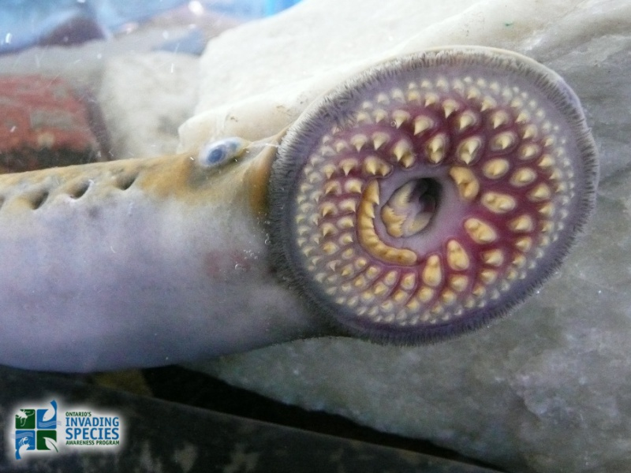
Vampire Invaders from out of Place
What kind of creature is this, and why are we concerned about it?
A Fish
A Snake
An Eel
A Helicoprion
A Lamprey

Slide 5
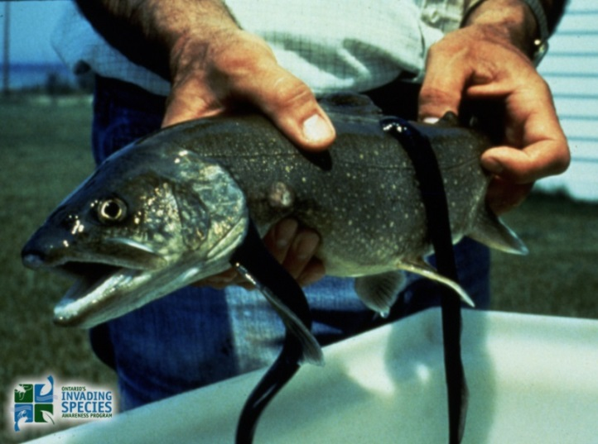
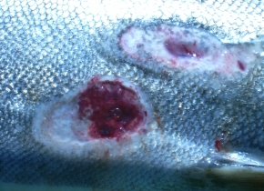
Vampire Invaders from out of Place
E) A Lamprey
These parasites were able to access the great lakes due to canals opened by humans for shipping routes.
The sea lamprey feed on the native fish species, drastically reducing their populations and making them more vulnerable to extinction.
http://www.invadingspecies.com/invaders/fish/sea-lamprey/ (Fish above and prior page)
http://britishseafishing.co.uk/sea-lamprey/ (Wounds at right)

Slide 6
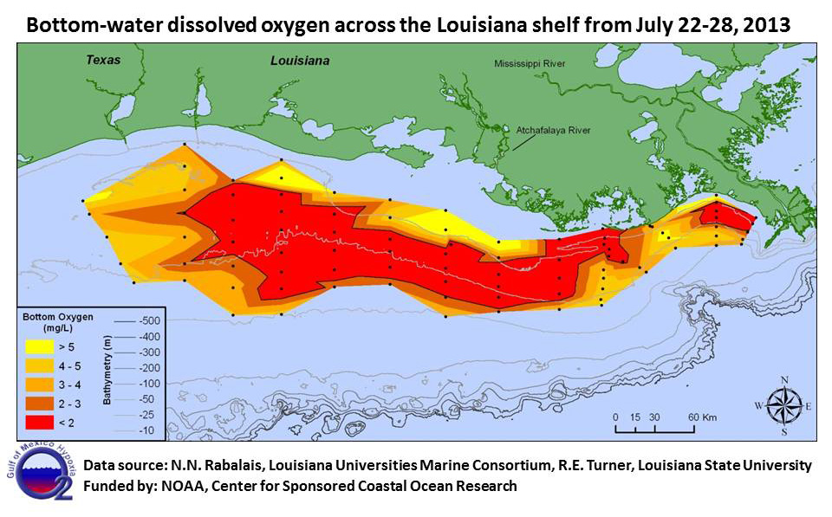
The Gulf of Mexico Death Zone
What is the cause of the oxygen shortage in the deep waters of the Gulf of Mexico each summer?
Fertilizer used on Farms
High Atmospheric CO2 Concentrations
Oil Spills
Overfishing
Shark Attacks
http://serc.carleton.edu/microbelife/topics/deadzone/index.html (Map Above)

Slide 7
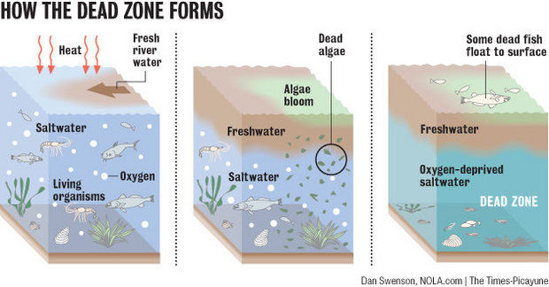
The Gulf of Mexico Death Zone
-Nutrients from the fertilizers get washed down the Mississippi river and into the Gulf of Mexico
A) Fertilizer used on Farms
-Phytoplankton grow rapidly and when they die decomposition uses up nearly all of the oxygen in the deeper waters
http://www.gulfhypoxia.net/news/default.asp?XMLFilename=201507011440.xml (Diagrams above)

Slide 8
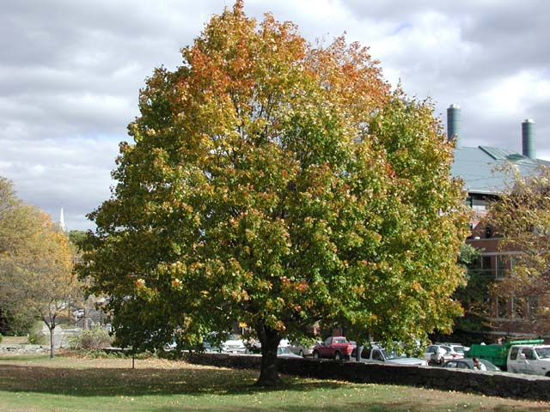
The Montreal Maple Leafs?
Which species of tree do you think is the most common in and around Montreal?
Red Ash
Norway Maple
Sugar Maple
Silver Maple
Skyline Honey Locust
http://www.eddmaps.org/ipane/ipanespecies/trees/Acer_platanoides.htm

Slide 9
The Montreal Maple Leafs?
B) Norway Maple
-The Norway maple is an invasive species from Europe. Some scientist believe it can even release chemicals into the soil that kill other (competing) plants.
-Many Norway Maples were planted in Montreal to replace the trees lost to mayor Drapeau’s morality cuts. They have since spread rapidly over the island and surrounding areas.
http://www.eddmaps.org/ipane/ipanespecies/trees/Acer_platanoides.htm

Slide 10
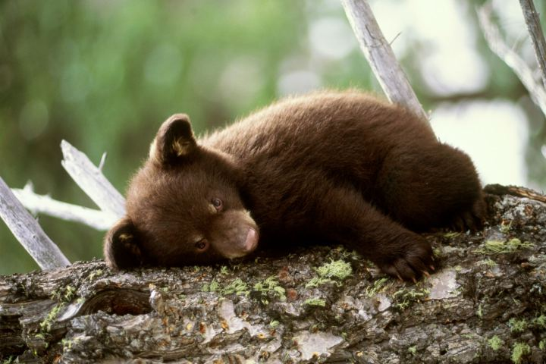
Bear Bones
Canadian black bears are killed by trophy and for-profit hunters, of the 300 000 black bears in Canada, how many are killed each year by hunting?
3 000 (~1%)
30 000 (~10%)
60 000 (~20%)
80 000 (~27%)
http://darwin.bio.uci.edu/sustain/global/sensem/nguyen97.htm (Statistics) http://swampland.time.com/2013/02/15/making-it-legal-to-touch-bear-cubs-and-other-unusual-state-bills/ (Image)

Slide 11
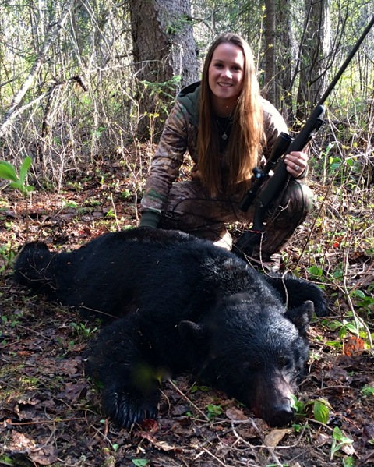
Bear Bones
D) 80 000 Black Bears Annually
-Despite the legal limit for black bear hunting being 2 bears per hunter per year, almost a third of Canada’s black bear population is taken by hunting each year, more than half of which is done illegally.
-However, black bears are still not considered to be an at risk species by Environment Canada.
-The paws and gall bladders of black bears are extremely valuable in some parts of the world. Gall bladders can be worth $20 000 to some buyers/smugglers.
http://www.inzanaoutfitters.com/blackbearhunting.html (photo)

Slide 12
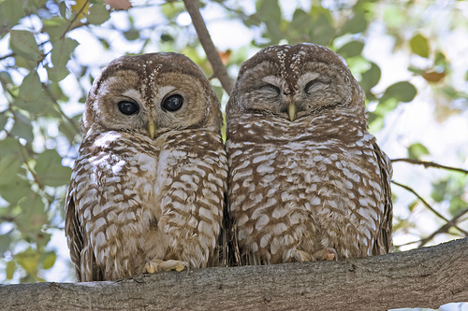
Owl Wars, Who gives a Hoot?
Spotted owls are in a desperate battle for territory against barred owls invading from the east. A new research effort is trying to help the spotted owls in an unusual way, what do you think that is?
Chopping down trees with barred owl nests
Blasting barred owls out of the sky with shotguns
Sterilizing captured barred owls (No reproduction)
Developing a disease that only kills barred owls
http://speezees.com/northern-spotted-owl/ (Above image)

Slide 13
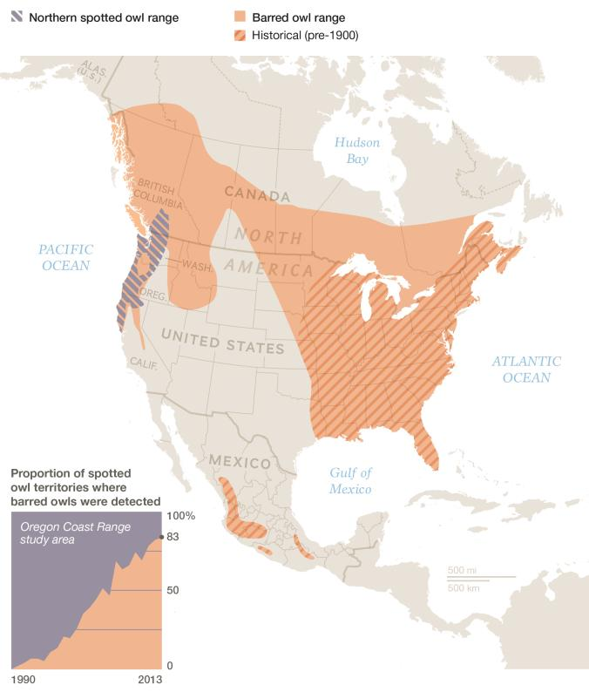
Owl Wars, Who gives a Hoot?
B) Blasting barred owls out of the sky with shotguns
-While still in a trial stage, the lethal removal of the invasive barred owls seems to be allowing the spotted owl populations to recover.
-Barred owls are native to the East coast and it’s hypothesized that they were able to move through different habitats in Central Canada due to the trees planted in suburban areas. Other research suggests that global warming allowed the barred owls to inhabit the boreal forest.
http://news.nationalgeographic.com/news/2014/07/140717-spotted-owls-barred-shooting-logging-endangered-species-science/

Slide 14
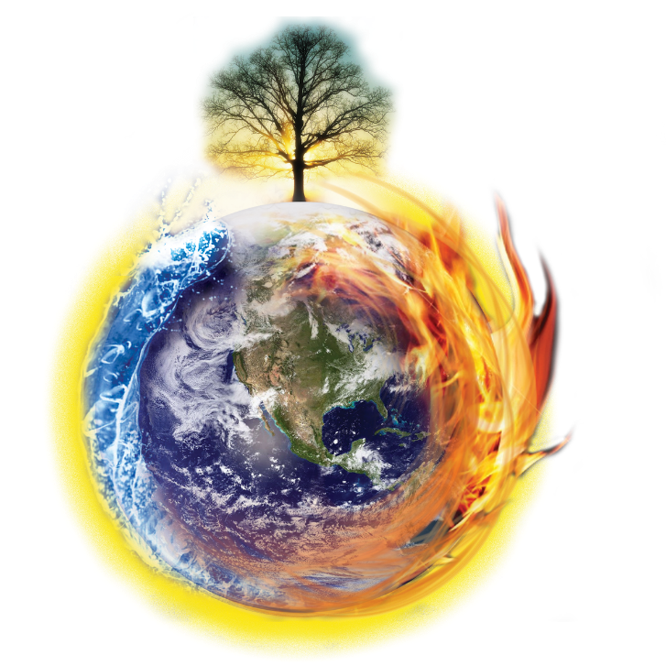
Climate Change: The Bad, the Ugly & the Scary
The impact that we (humans) are having on the climate of our planet is talked about in almost all fields of modern science. Can you name some of the effects and signs of climate change that we might see in the news or our day to day lives?
Slide Show via CNN http://www.cnn.com/2014/09/24/world/gallery/climate-change-impact/
http://cald.org/site/cald/?page_id=8033

Slide 15
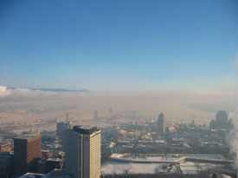
$CO_{2}$ Emissions, How much is too much?
Canadians produce about 700 megatons of carbon dioxide (or equivalent greenhouse gases) each year. What would have a similar mass to all that greenhouse gas?
All the blue whales in the world (~10 000)
All the skyscrapers in the world (~2500)
The Great Pyramids at Giza
The combined mass of all living Canadians
The combined mass of all living humans
http://www.mddelcc.gouv.qc.ca/air/info-smog/

Slide 16
$CO_{2}$ Emissions, How much is too much?
All the blue whales in the world (~10 000)
All the skyscrapers in the world (~2500)
The Great Pyramids at Giza
The combined mass of all living Canadians
The combined mass of all living humans
200T per whale x 10 000 = 2 000 000 Tons
-Too Light-
222 500T per tower x 2500 = 556 250 000 Tons
Pretty Close!
3T per block x 2 000 000 blocks = 6 000 000 Tons -Too Light-
0.08T each x 35 000 000 people = 2 800 000 Tons
-Too Light-
0.06T each x 7 300 000 000 people = 438 000 000Tons Pretty Close!

Slide 17
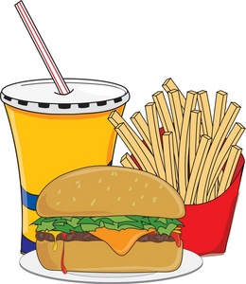
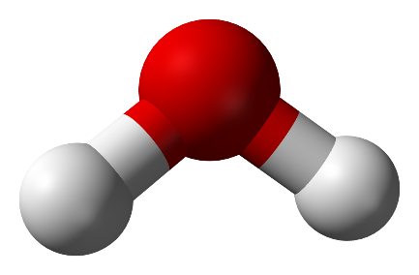
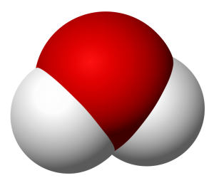
Gross! My Cheeseburger’s all Soggy!
Water is our most valuable resource and we use it for almost everything. From manufacturing to cooking, from cleaning to artistic expression and scientific research. How much water do you think it takes to make a fast food meal? (Burger + Fries + Soda)
25 Liters
130 Liters
2300 Liters
8400 Liters
$$H_{2}O$$

Slide 18
Gross! My Cheeseburger’s all Soggy!
C) 2300 Liters of Water
When you take into account all the water needed to grow the plants that feed the cow, produce flour and sesame for the bun, lettuce, mustard, tomatoes and all those fixings it really adds up. Growing and processing a single potato to make French fries can require several hundred liters of water. And getting that water where it needs to be can take a lot of energy.
$$H_{2}O$$

Slide 19
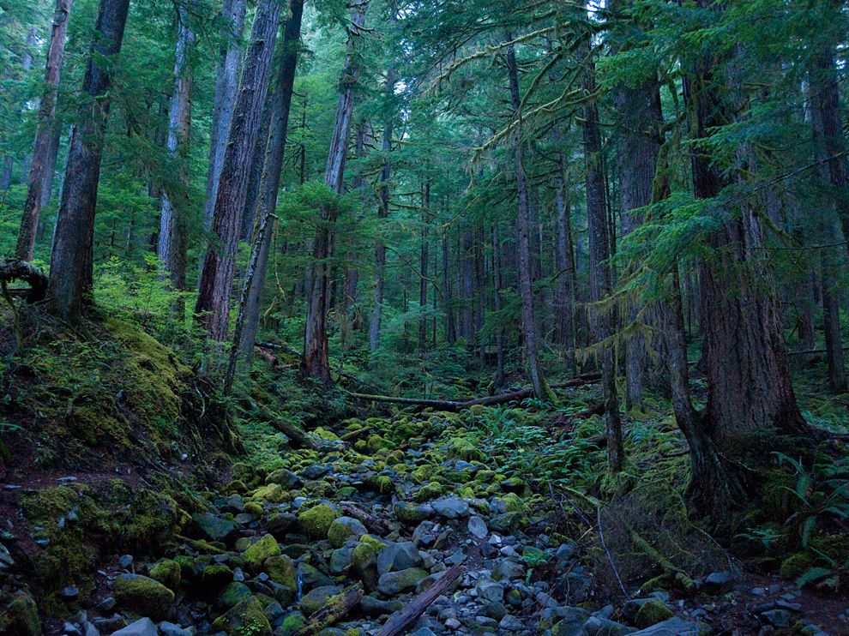
The Lungs of the Earth
We read and hear a lot about the rainforest being cut down and that a lot of plant and animal species could be lost forever if we lose these tropical habitats. If they’re so important, why are we cutting them down in the first place‽
Room to graze cattle
Make space for farmland
Mining or oil drilling
Logging
Hydroelectric development
http://photography.nationalgeographic.com/photography/photo-of-the-day/hoh-rain-forest-olympic-national-park/

Slide 20
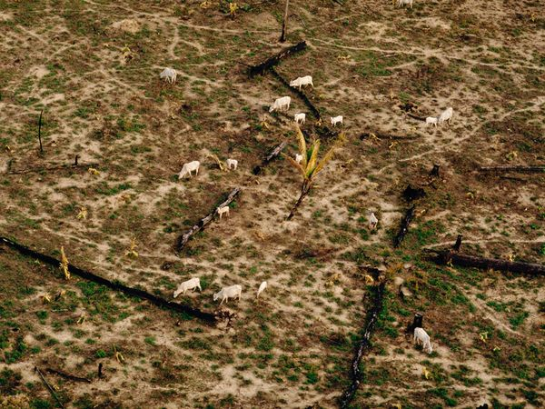
The Lungs of the Earth
Room to graze cattle
While ranching is the largest contributor to the destruction of rain forest ecosystems, particularly in Central and South America, all of the other choices are also partially correct. Ranching is often accompanied by agriculture/farming and logging. The toxic chemicals from mining operations also threaten these ecosystems, as does flooding from hydroelectric dam construction.
http://www.rainforestconcern.org/rainforest_facts/why_are_they_being_destroyed/ (Statistical Info)
http://environment.nationalgeographic.com/environment/photos/rainforest-deforestation/#/teak-logs_400_600x450.jpg (Image)

