Slide 1
Periodic Table Review

Slide 2
Periodic Table
Visual representation of elements
Organized by chemical and physical properties
Current table created by Dmitri Mendeleev
Illustrates periodic trends in the elements!
Columns → GROUPS
Rows → PERIODS

Slide 3
Groups in Periodic Table
Elements in same groups = same number of valence electrons
Valence electron → electrons found in the last orbital!
Elements with same valence electrons have similar chemical properties, since they all have the same ability to gain/loose electrons

Slide 4
Periods in Periodic Table
Elements in same period= same number of orbitals /energy shells
The number of orbitals also illustrate the overall size of the element
An element in period 2 is smaller than an element in period 6, since it has only two orbitals while the latter has 6

Slide 5
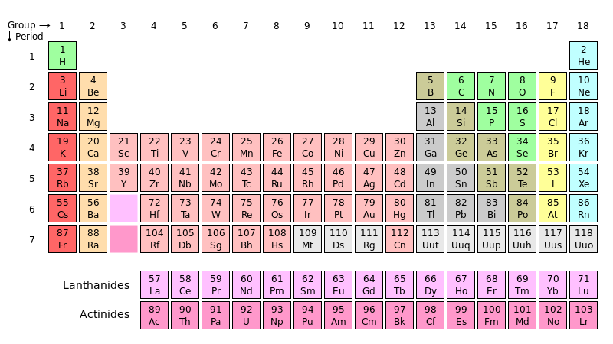
Alkali Metals
Alkaline Earth
Chalcogens
Halogens
Noble Gases

Slide 6
Groups in Periodic Table
Metals
Groups 1, 2, 3 and transition metals
All left of staircase
Main properties include: malleable, ductile, conduction of heat and electricity, shiny, solid form at room temp. (**except Hg), react with acids
**Higher the period=more reactive**

Slide 7
Groups in Periodic Table
Non-Metals
Groups 4, 5,6,7 and 8
All right of staircase
Main properties include: not-malleable, non-ductile (fragile/breakable), poor conduction of heat and electricity, dull, found in all three states of matter at room temp.
**Lower the period=more reactive**

Slide 8
Groups in Periodic Table
Metalloids
Found on the staircase: Boron, Silicon, Germanium, Arsenic, Antimony, Tellurium
Have characteristics of both metals and non-metals

Slide 9
Families in Periodic Table
Alkali Metals
Found in Group 1
Extremely reactive; most reactive of all families, elemental form must be emerged in oil or will react with oxygen violently
Alkaline Earth Metals
Found in Group 2
Reactive, less so than Alkali Metals, can be exposed to oxygen

Slide 10
Families in Periodic Table
Halogens
Found in Group 7
Form salts when react with metals
Noble Gases
Found in Group 8
Are all in Gas form
Never found in a compound; orbitals are full and are stable

Slide 11
Bohr Model vs Lewis Dot Diagrams
Bohr models contain the following information
Number of protons (**and neutrons**), Number of total electrons, valence electrons, orbitals
Lewis D.D only contain valence electrons
Note, it is not necessary to write # of neutrons

Slide 12
