Slide 1
The pH Scale

Slide 2
Distinguish
In order to distinguish between acids, bases and neutral solutions we use pH
pH is actually indication of H⁺ ions in that solution
Measurable in various ways
pH meter
Indicator papers

Slide 3
pH Scale
Scale ranges from 0-14
pH <7 → acidic
pH =7 → neutral
pH >7 → basic
The pH scale is logarithmic
A solution with a pH of 3 is 10 times more acidic than a solution with a pH of 4.
A solution with a pH of 9 is 100 times less basic than a solution with a pH of 11.

Slide 4
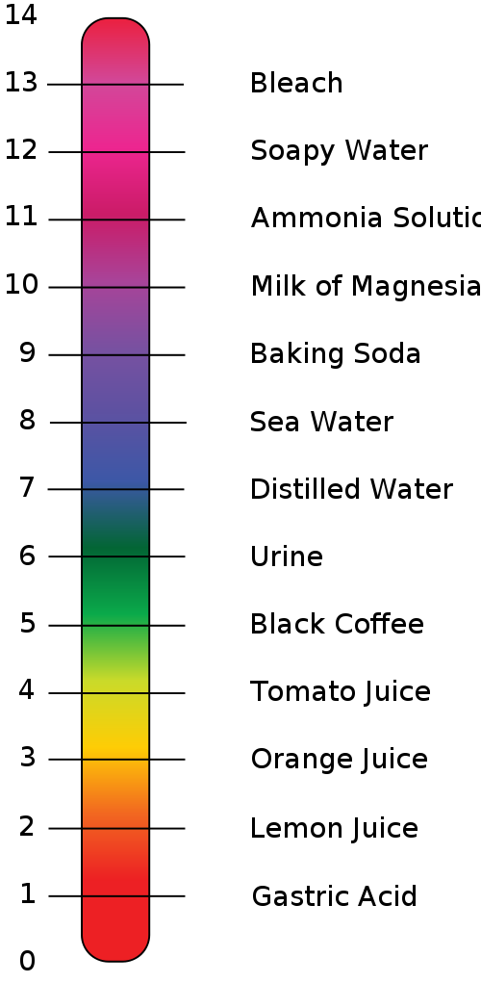
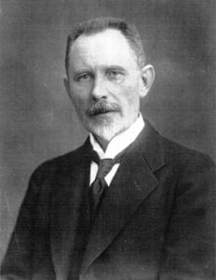
Common pH
Soren Sorenson introduced the concept of pH in 1909.

Slide 5
Apply the idea
Rain and snow are slightly acidic with a pH of about 5.5
In Quebec, the pH tends to be around 4.5
How would this affect the landscape of Quebec?
A Lake`s pH is between 8.5 and 6. If a lake becomes too acidic between 6 and 5.5, acidic intolerant life forms begin to disappear, up to 25% of fish species. If it drops below 5.5 up to 75% of fish species may be lost. If a lake pH drops below 5, fish can no longer reproduce, and will perish due to lack of food

