Slide 1
Types of Reactions

Slide 2
Main types of reactions
Synthesis reactions
Decomposition reactions
Displacement reactions
Neutralization reactions
Oxidation reactions
Combustion reactions
Cellular respiration
Photosynthesis

Slide 3
Synthesis Reaction
Element + Element → Compound
This type of reaction has usually 2 reactants and only one product
2H2 + O2 → 2H2O

Slide 4
Decomposition Reaction
Compound → Element + Element
This type of reaction, you start off with one thing and end up with two!
2H2O → 2H2 + O2

Slide 5
Displacement Reaction
ab + cd → ac + bd
You start off with two reactants, and end up with two products, which are different from your starting compounds!
2KI+Pb(NO3)2 → PbI2 + 2KNO3

Slide 6
Neutralization reaction
Reaction between an acid and a base
Technically a type of single displacement reaction, since the elements in the acid compound and base compound are switching
Acid + Base → Salt + Water
Examples
HCl + NaOH → NaCl + H2O
HBr + KOH → KBr + H2O

Slide 7
Oxidation Reaction
Reaction where one of the reactants is oxygen!
Metal rusting
Cu + O2→ 2CuO
Food rotting
These three reactions are all examples of oxidation reactions, since oxygen is a reactant!

Slide 8
Combustion Reaction
A type of oxidation reaction (since oxygen is involved), but this reaction releases a large amount of energy in the form of heat
For combustion to occur, three things must be present:
Fuel
Oxidizing agent (usually oxygen)
Ignition temperature (heat)

Slide 9
Combustion Reaction
A fire will naturally occur when all three elements are combined in the right mixture
The removal of any of the elements results in the extinguishing/preventing the fire
If the fuel is a hydrocarbon (substance with H and C in it) the resulting reaction is the following:
Fuel + oxygen → Heat + water + carbon dioxide

Slide 10
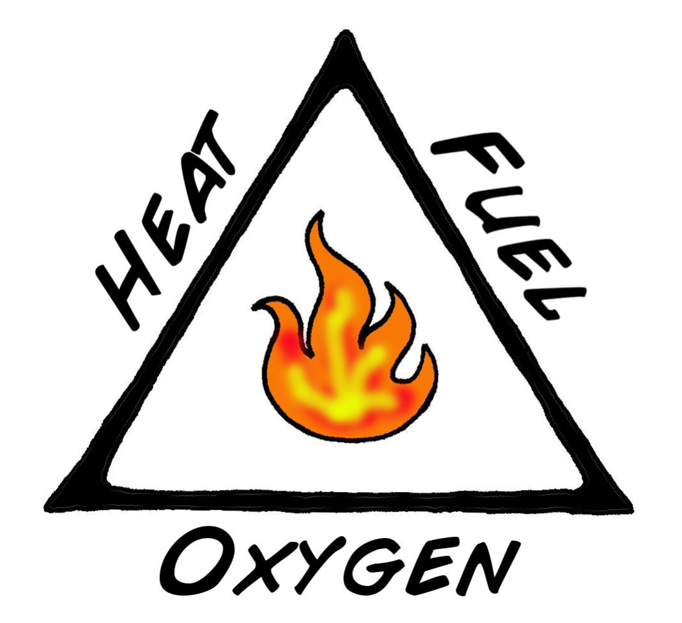
Combustion Reaction
Ignition Temperature: Minimum temperature needed for combustion to occur
Fuel:
Substance which undergoes combustion by reacting with the oxidizer
Oxidizing Agent:
Substance which allows for the fuel to ignite

Slide 11
Types of Combustion
Rapid
Large amounts of heat and energy are released, often results in a flame!
Spontaneous
Type of combustion that starts without an external ignition source
The “heat” side of the fire triangle; in rapid and slow combustions you need an external source of ignition to start off the reaction; once started the heat produced fuels it along
Slow
Reaction is slow and have gradual release of energy over time. Usually does not produce a flame.

Slide 12
Cellular Respiration
Process where the chemical energy trapped in “food” molecules is released and captured in ATP
Fuel for the reaction is glucose, which comes from
Carbohydrates
Proteins
Lipids

Slide 13
Cellular Respiration
Net Formula
C₆H₁₂O₆ + 6O₂ → 6CO₂ + 6H₂O + energy
Cellular respiration releases energy which you’re cells use for normal growth/repair functions (basically to stay alive!)
Main waste product → CO₂
All living things perform cellular respiration

Slide 14
Photosynthesis
Process where solar energy from the sun is trapped and stored in chemical bonds (glucose!)
Recall: Cellular respiration breaks down glucose to release energy, photosynthesis traps energy by making glucose!
Photosynthesis is done by photoautotroph (things that make their own food via photosynthesis, a.k.a plants!)

Slide 15
Photosynthesis
Net formula
6CO₂ + 6H₂O +energy (light) → C₆H₁₂O₆ + 6O₂
Main “waste” product → O₂
Plant’s waste is our benefit!
Only photoautotroph undergo photosynthesis
Only plants do this!

Slide 16
Name that type of reaction!
6CO₂ + 6H₂O +energy (light) → C₆H₁₂O₆ + 6O₂
PHOTOSYNTHESIS
CH₄ + 2O₂ → CO₂ + 2H₂O
COMBUSTION
HNO₃ + LiOH → H₂O +LiNO₃
NEUTRALIZATION
NH₄OH → NH₃ + H₂O
DECOMPOSITION
N₂ + 3H₂ → 2NH₃
SYNTHESIS
Fe + CuSO₄ → FeSO₄ + Cu
REPLACEMENT

